Slide 1
Humanities Data Praxis
Elizabeth Wickes (Research Data Services, UIUC)
Eleanor Dickson (Scholarly Commons, UIUC)
Andrea Thomer (School of Information Sciences, UIUC)
10 March 2017

Slide 2
Humanities data — the very idea
Data?
$#%@@$# !!

Slide 3
Data: some definitions
a collection of facts from which conclusions may be drawn
(wordnet.princeton.edu/perl/webwn)
Factual information (such as measurements and statistics) used as a basis for reasoning, discussion, or calculation.
(www.ic.gc.ca/eic/site/stco-levc.nsf/eng/h_qw00037e.html)
a collection of organised information, usually the result of experience, observation or experiment, … may consist of numbers, words, or images, particularly as measurements or observations
(en.wikipedia.org/wiki/Data)
A collection of observations.
(www.fs.fed.us/r3/coconino/forest-resources/archaeology)
information, especially information organized for analysis
(www.handsontheland.org/lms/mod/glossary/view.php)

Slide 4
Data, our* definition
Data are propositions
(i) systematically asserted. . .
(ii) as evidence
*Dubin et al. 2009-2014, various Renear lectures
Notes:
A fancy way of saying: statements that we argue represent proof of some phenomena or truth about the world

Slide 5
Data, our* definition
Data are propositions
(i) systematically asserted. . .
(ii) as evidence
In the sciences data can look like:
A series of observations, rendered as numbers, analyzed with statistics
In non-science, data can look like:
A collection of texts, rendered in words, interpreted qualitatively
In interdisciplinary work data can look like:
All of the above (and more)
*Dubin et al. 2009-2014, various Renear lectures
Notes:
In the sciences this can look like:
- A series of observations, rendered as numbers, analysed with statistics
In non-science, this can look like:
A series of texts, rendered in words, interpreted qualitatively
In interdisciplinary work this can look like:
All of the above!

Slide 6
Your data
What kind of data do you have or work with?
How is it organized and encoded (written onto some sort of media)?
[audience participation]

Slide 7
Data, our* definition
Data are propositions
(i) systematically asserted. . .
(ii) as evidence
When using computers to analyze any kind of data,
they need to be presented in a particularly systematic way – otherwise the computer won’t know what to do with it.
That’s where data cleaning/wrangling/curation comes in…
*Dubin et al. 2009-2014, various Renear lectures
Notes:
In the sciences this can look like:
- A series of observations, rendered as numbers, analysed with statistics
In non-science, this can look like:
A series of texts, rendered in words, interpreted qualitatively
In interdisciplinary work this can look like:
All of the above!

Slide 8
Agenda – an entirely too brief overview of data cleaning tools and techniques
Hands on: Spreadsheet activity
Hands on: Tidy data in Excel
[break]
Follow along: Normalized data in Open Refine
Follow along: Charting data in R

Slide 9
Cleaning data with OPenRefine
Andrea Thomer

Slide 10
If you’re following along -
Locate the file named “Menu.csv” and we’ll review the data together
Notes:
NB: we’re using a slightly older, messier version of the menus data than what’s currently online.

Slide 11
Introducing OpenRefine
OpenRefine is a tool for manipulating
and cleaning data.
OpenRefine looks like a spreadsheet,
but it acts like a database.
Use OpenRefine to explore, clean,
and link your data.
Notes:
Originally known as Freebase Gridworks and later as Google Refine, the tool became an open community resource in 2012.

Slide 12
Today we will cover….
Creating a New Project
Basic Normalization
Faceting and Clustering
Records vs. Rows
Advanced Transformations
(if we have time) (we probably won’t)
Notes:
-- Note that it runs on desktop but opens in browser.
-- Demonstrate how to create a new project; how to do basic normalization; how to facet and cluster
-- Hands on exercise for 15 minutes (if there are advanced users, start a break-out discussion group)

Slide 13
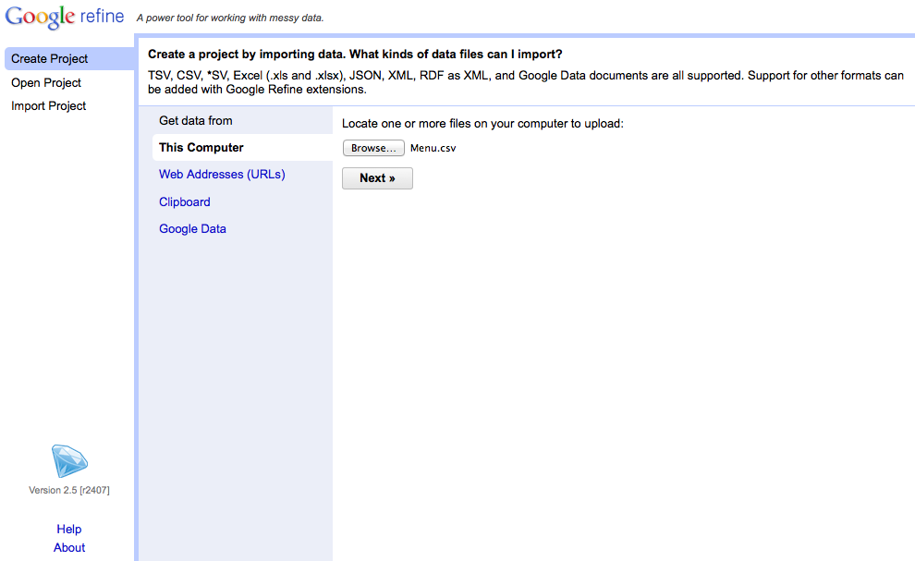
Creating a Project
Notes:
-- Choose create project (notice that you can also open projects you’ve worked on previously or import projects. The import feature is especially useful for collaboration)
-- Upload “Menu.csv”. Caveat: the other files are very large. It’s possible to allocate additional memory to Open Refine when working with large datasets, but not for the purposes of this demo. If this is important to you, we can discuss it during the hands-on session.

Slide 14
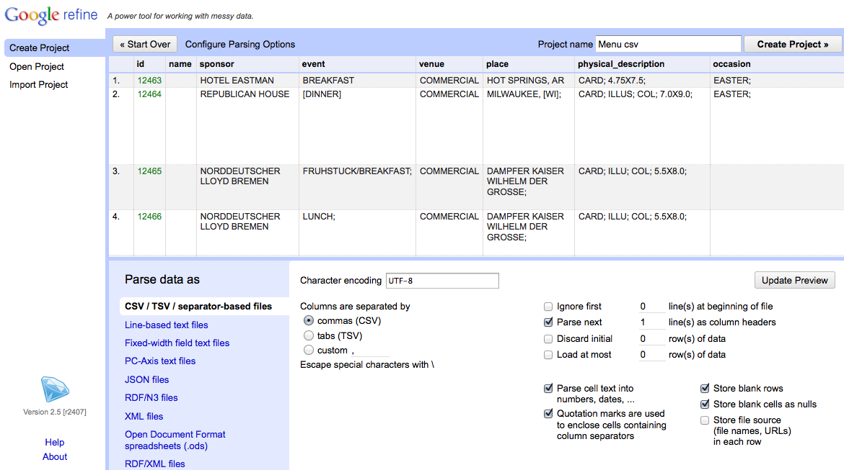
Creating a Project
Notes:
-- Use the preview window to review the data
-- Notice the parse options
-- for this data set, be sure that character encoding is UTF-8, Columns are set as CSV, and first line is parsed as a header
-- note quotation marks option. In this case, we have it checked, but it you use quotations in your data set for other purposes it may cause parsing issues
-- When you selected among options, click “update preview”, review again, and if all looks well, choose a project name and click “create project”

Slide 15
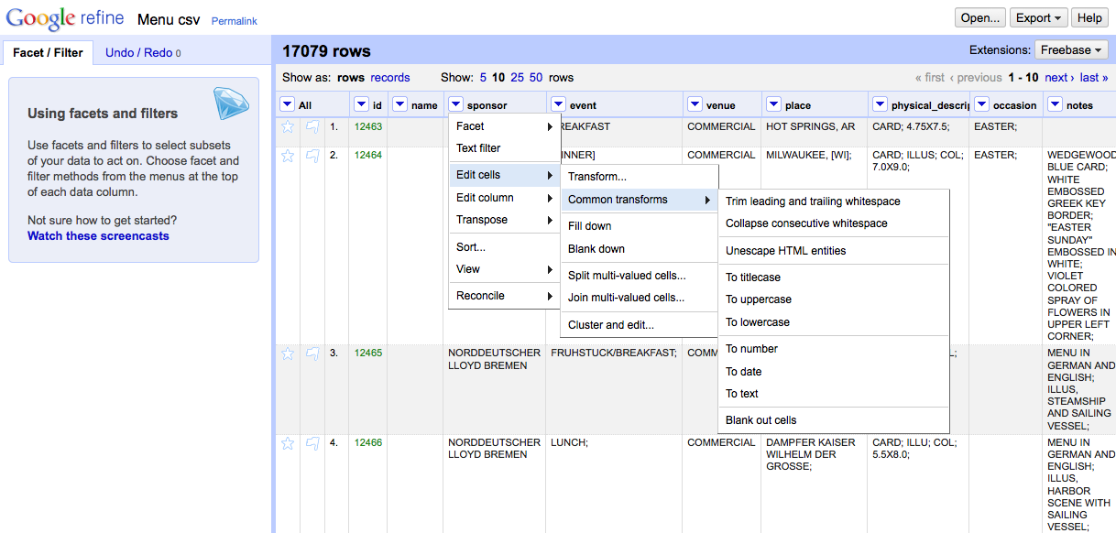
Basic Normalization
Other ones to try:
Collapse consecutive whitespace
Change to title/lower/upper case
Notes:
-- click the arrow to the left of sponsor for a drop-down menu (notice the option your menu options)
-- choose edit cells
-- choose common transforms
-- start by trimming whitespace (you’ll notice that 14 cells were effected)
-- collapsing whitespace effects another 126 cells. Computers are better than humans at detecting white space.
-- also play with uniformly setting the cases

Slide 16
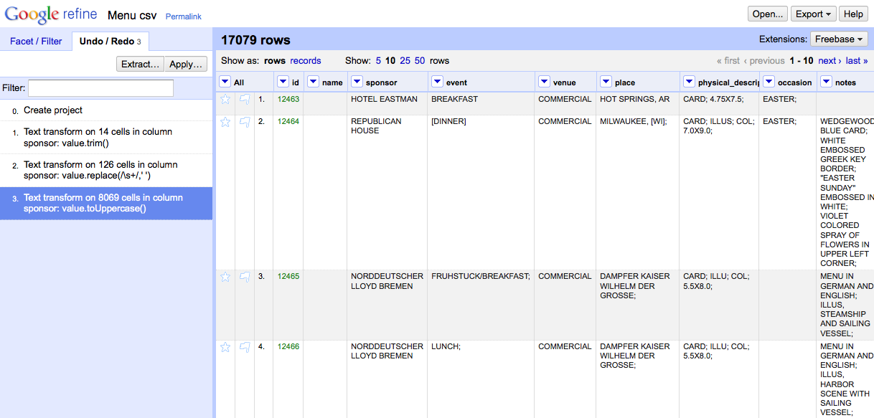
A Note on Tracking Project History
Don’t be afraid to make mistakes!
…you can always use the Undo/Redo tab to navigate to earlier stages in your project.
Notes:
Caveat: if you choose to navigate backward in your project history, you won’t be able to access any steps you’d taken after that point once you’ve made another change.

Slide 17
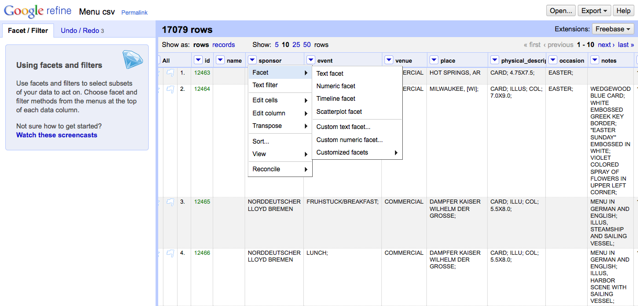
Faceting and Clustering
Notes:
-- Navigation to “Facet → Text facet”

Slide 18
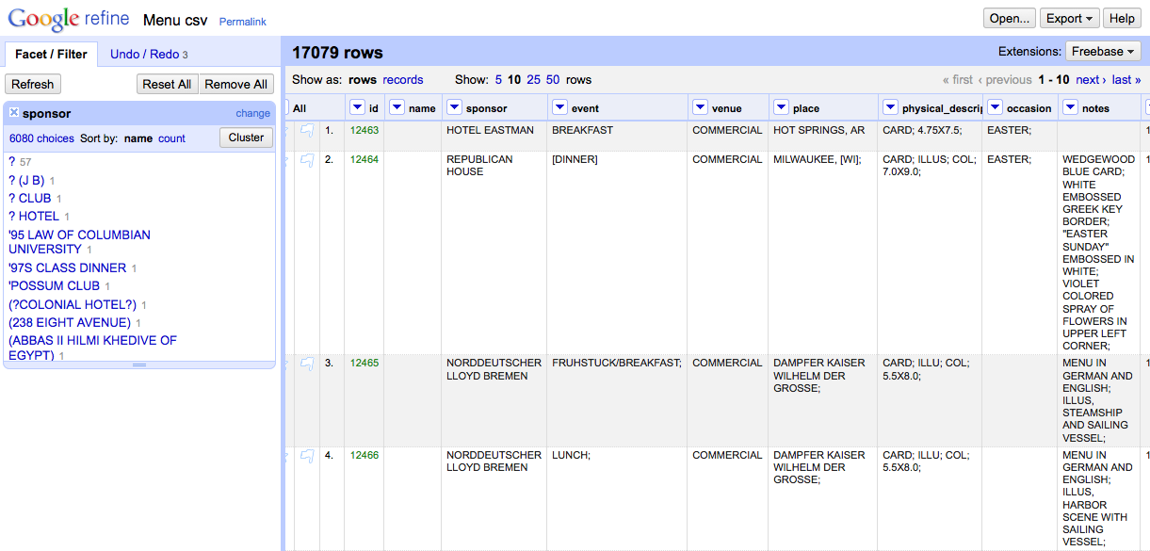
Faceting and Clustering
Notes:
-- Click “Cluster”

Slide 19
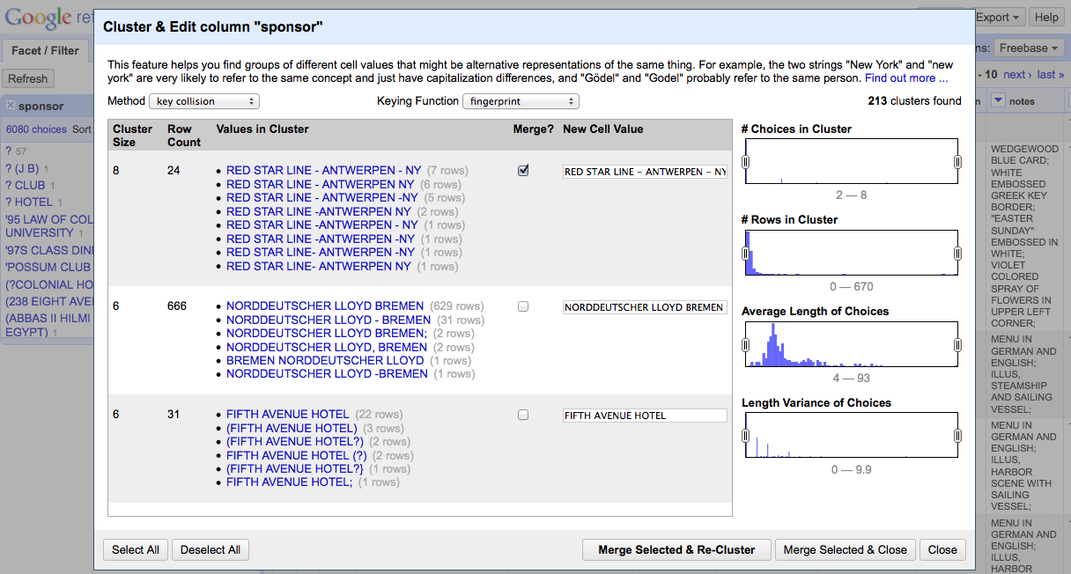
Faceting and Clustering
Notes:
-- For each cluster, review the values in the cluster, and (where needed) determine the preferred cell value.
-- Select the “Merge?” check box
-- Then select “Merge Selected and Re-Cluster”
-- Note that there are a few different clustering methods you can try, and they will return different results. I encourage you to play around with those settings and see what works best with your own dataset.

Slide 20
Kinds of Clustering
**PAUSE before continuing**
Key collision (fastest, safest)
Fingerprint, Ngram Fingerprint = defaults
Match normalized strings in different ways
Metaphone = English pronunciation
Nearest Neighbor
PPM = Partial matching
Levenshtein = edit distance
This can be computationally intensive – and can sometimes crash – so use with caution or patience on large data sets

Slide 21
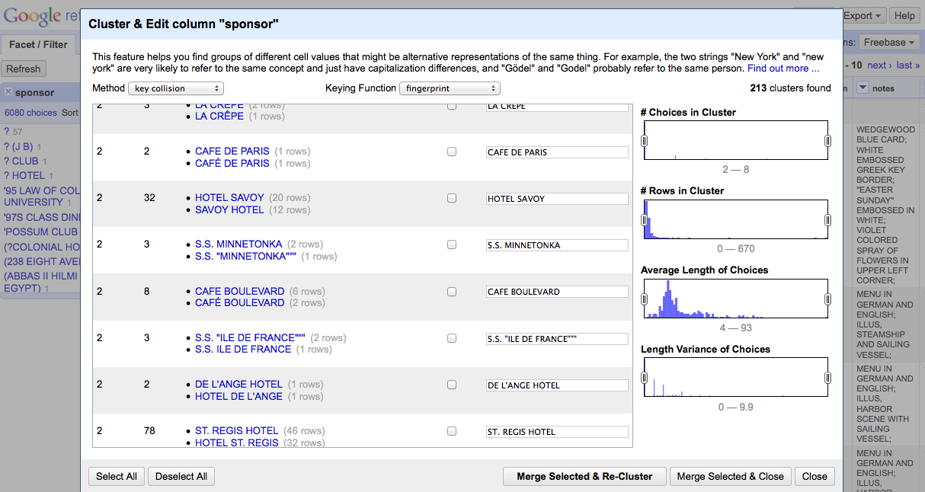
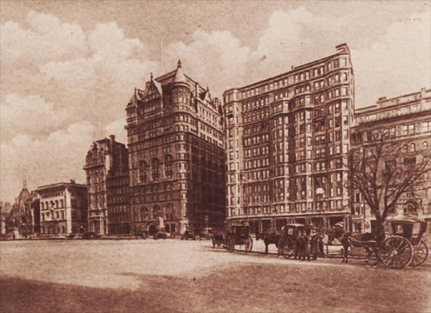
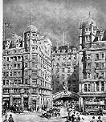
Be careful when clustering
This is part of that important “human-only” work we’ve talked about
Hotel Savoy
59th St. & 5th Ave.
New York, New York
Savoy Hotel
Strand
London WC2R 0EU
United Kingdom
Notes:
Just because their names are similar doesn’t mean they’re the same!
-- Today the Hotel Savoy is an Apple Store. The Savoy Hotel, famous for its cocktails, is still in operation.

Slide 22
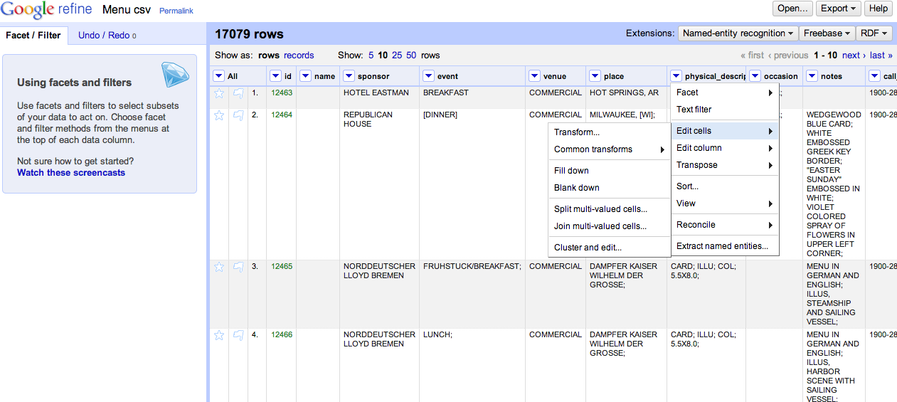
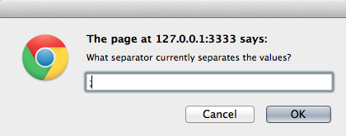
Records vs. Rows
Notes:
-- multivalued cells occur when many kinds of data are stuffed into a single cell. “Melville, Herman” as name, for example, could be split into two cells (last name, first name) In this example, we’ll use the physical description column, which includes several kinds of description per cell.
-- to review the different between records and rows, beginning by splitting some multi-valued cells

Slide 23
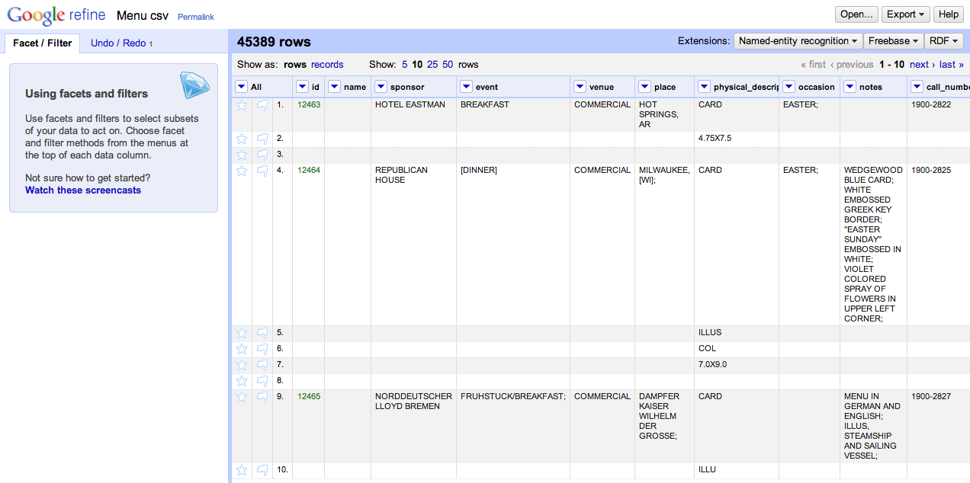
Multiple Values, Multiple Rows
Notes:
This is good if you’re only interested in specific values from the physical description, like whether or not menus are illustrated.
BUT, notice how the rest of rows 5, 6, and 7 are blank .

Slide 24
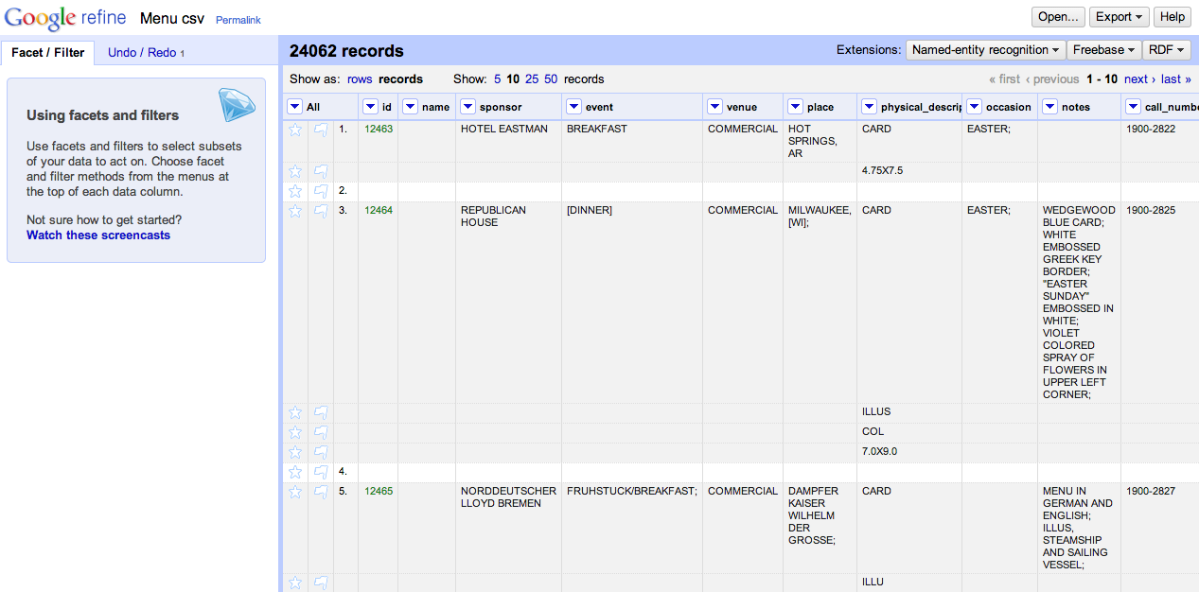
One Record, Multiple Rows
Notes:
Switching to the records view gives you the flexibility of gathering multiple rows together under the same ID.

Slide 25
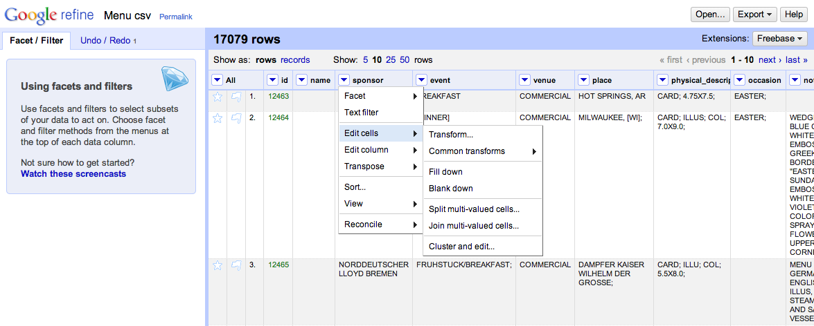
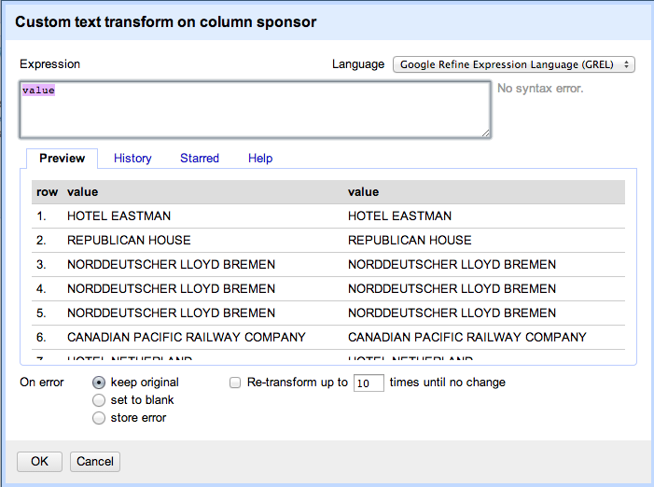
Advanced Transformations
Understanding Expressions:
https://github.com/OpenRefine/OpenRefine/wiki/Understanding-Expressions
GREL Cheat Sheet:
http://arcadiafalcone.net/GoogleRefineCheatSheets.pdf
Notes:
-- Before exploring on your own, I wanted to point out that you also have the option to do very sophisticated transformations using expressions.
-- Those of you familiar with regular expressions can try it out under “Edit cells → transformations”
-- Quick reference guide (created by Rod Whiteley)
-- If you aren’t familiar with using expressions, you might want to look at the introduction on Github to learn more.

Slide 26
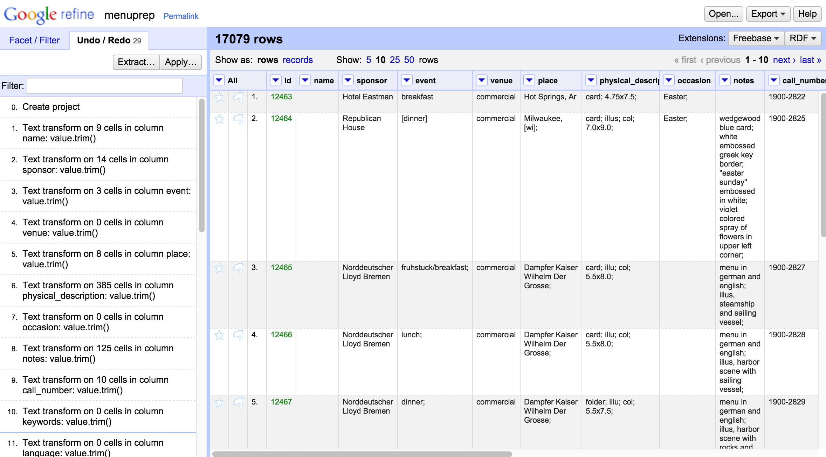
Extracting History as Provenance

Slide 27
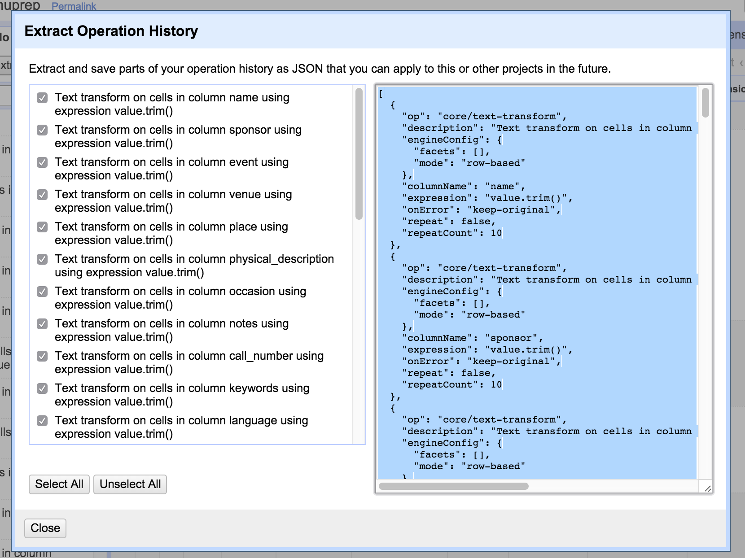
Extracting History as Provenance
Notes:
-- Chose which actions from your operation history that you’d like to extract
-- Then copy the JSON into a new text file

Slide 28
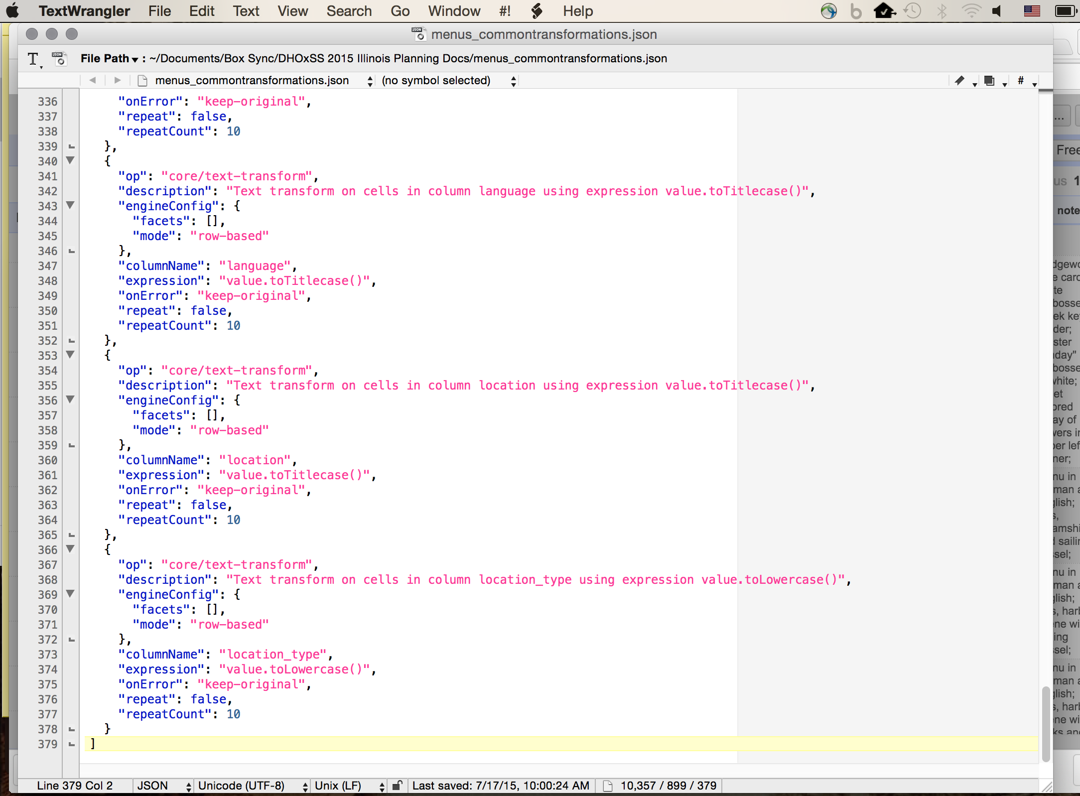
Extracting History as Provenance
Notes:
-- copy JSON into a new text file and save your work. (I’m using Text Wrangler here)

Slide 29
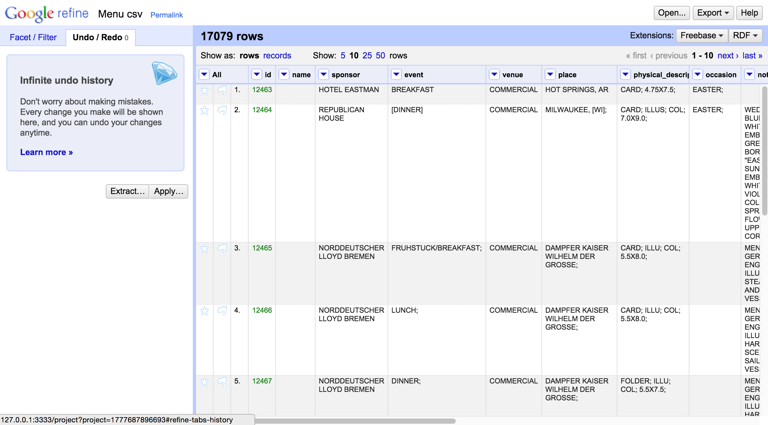
Applying JSON to New Project
Notes:
-- Now that you have your JSON file
-- You could re-open the menus data as a new project
-- and apply that JSON to replicate the same set of transformations

Slide 30
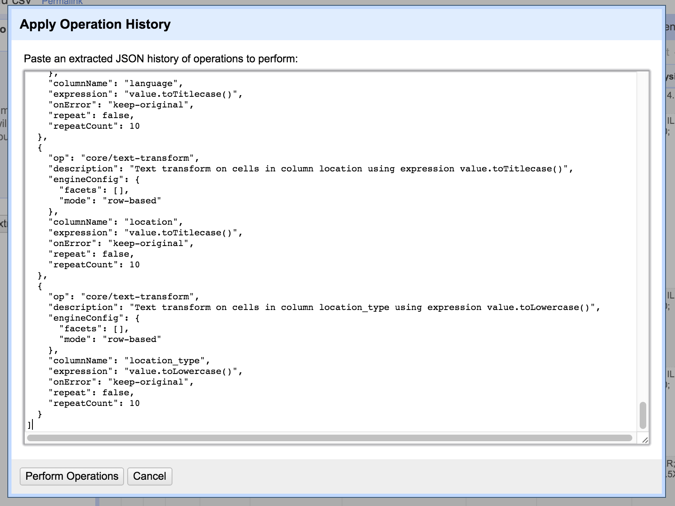
Applying JSON to New Project
Notes:
-- Copy your JSON from the text file you created into the blank text box
-- Click “Perform Operations”

Slide 31
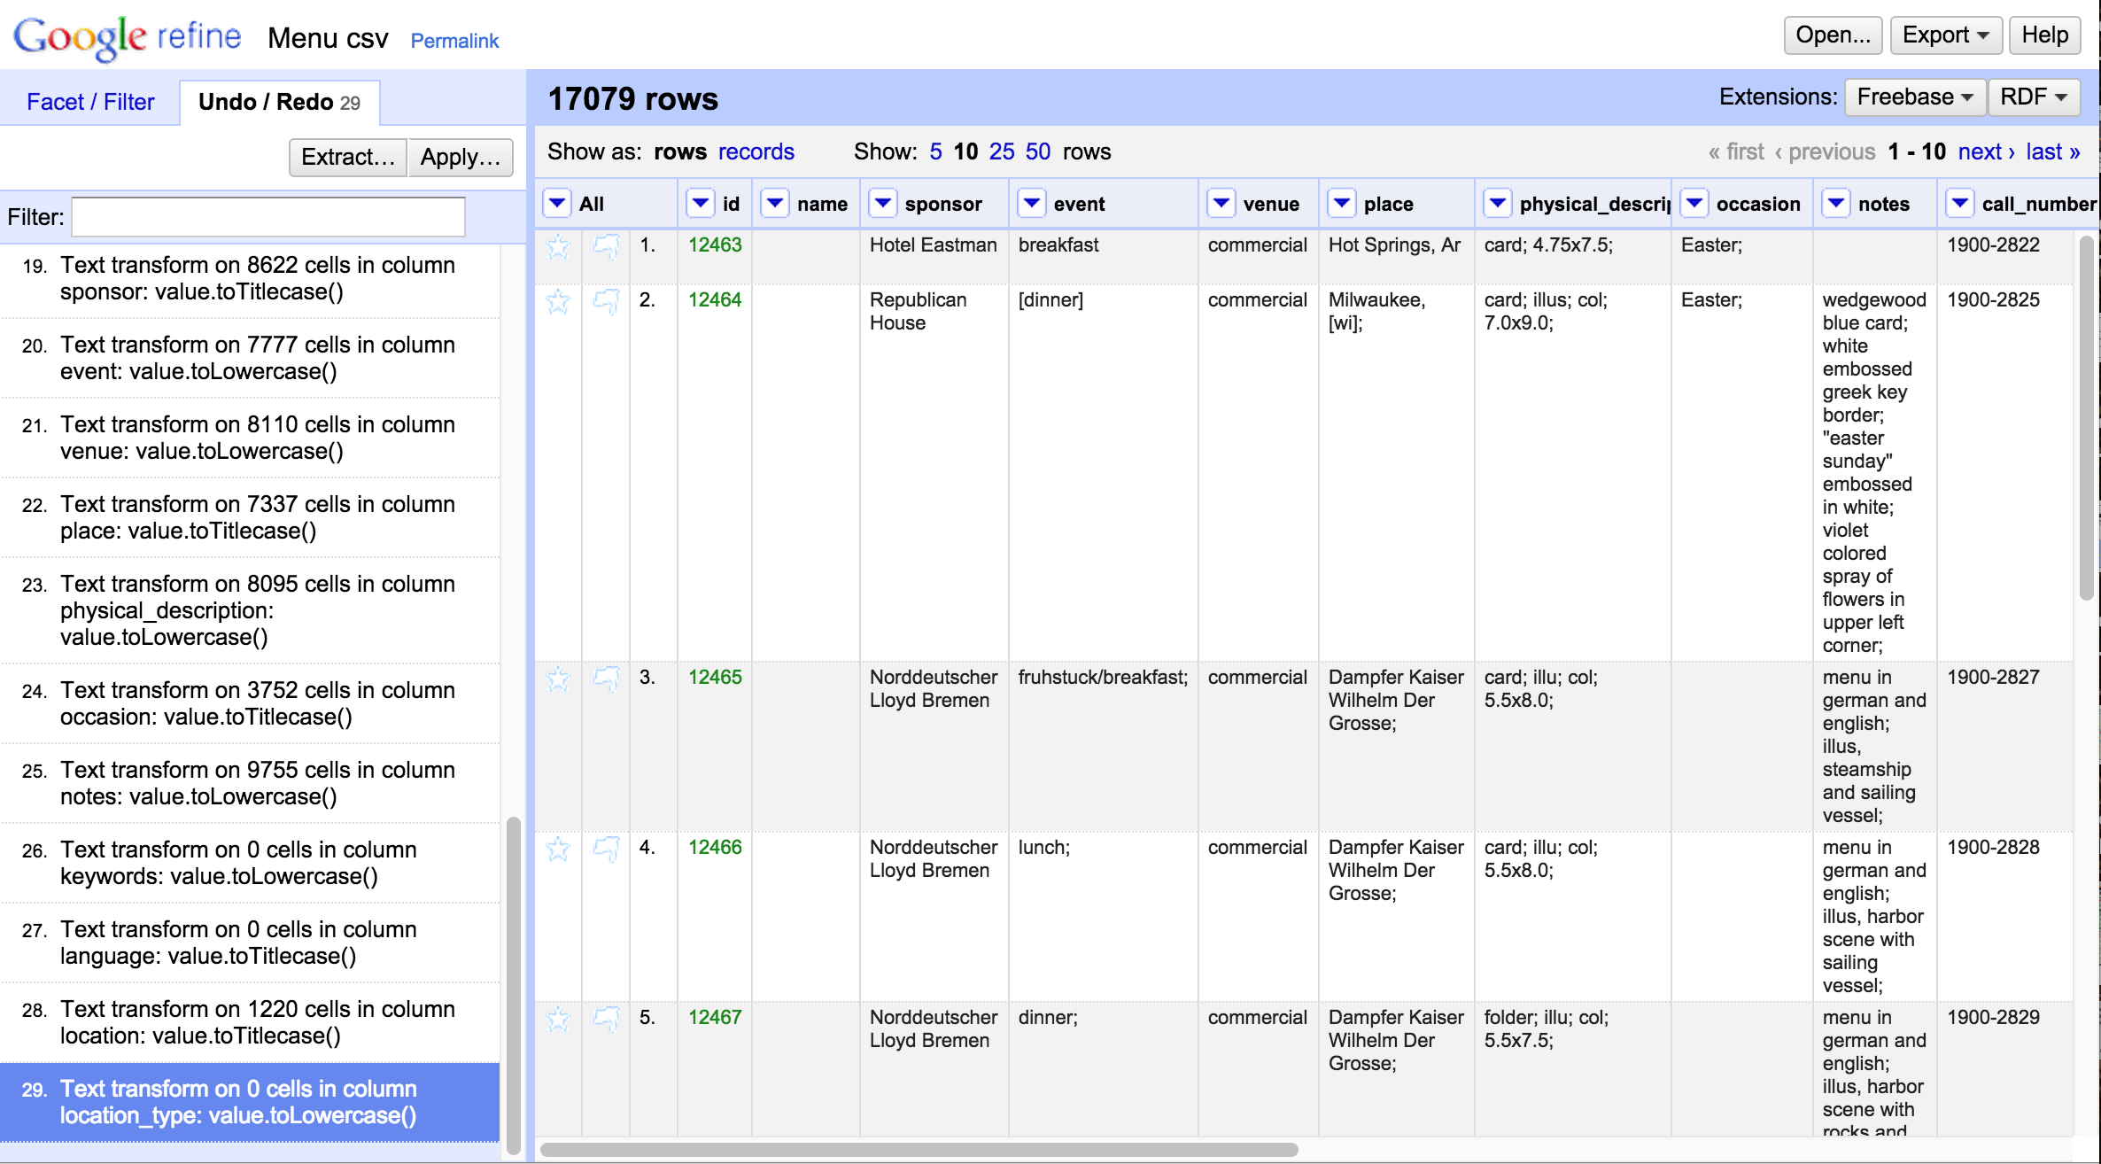
Applying JSON to New Project
Notes:
-- And now you can start your project having automatically completed a set of common transformations
-- This is useful if…
---- You want to document the changes you made to your data (protip: you do!)
---- You want to use a clean copy of your data set for multiple purposes
---- You have a series of files that have a similar organizational structure and you want to perform the same actions across multiple files

Slide 32
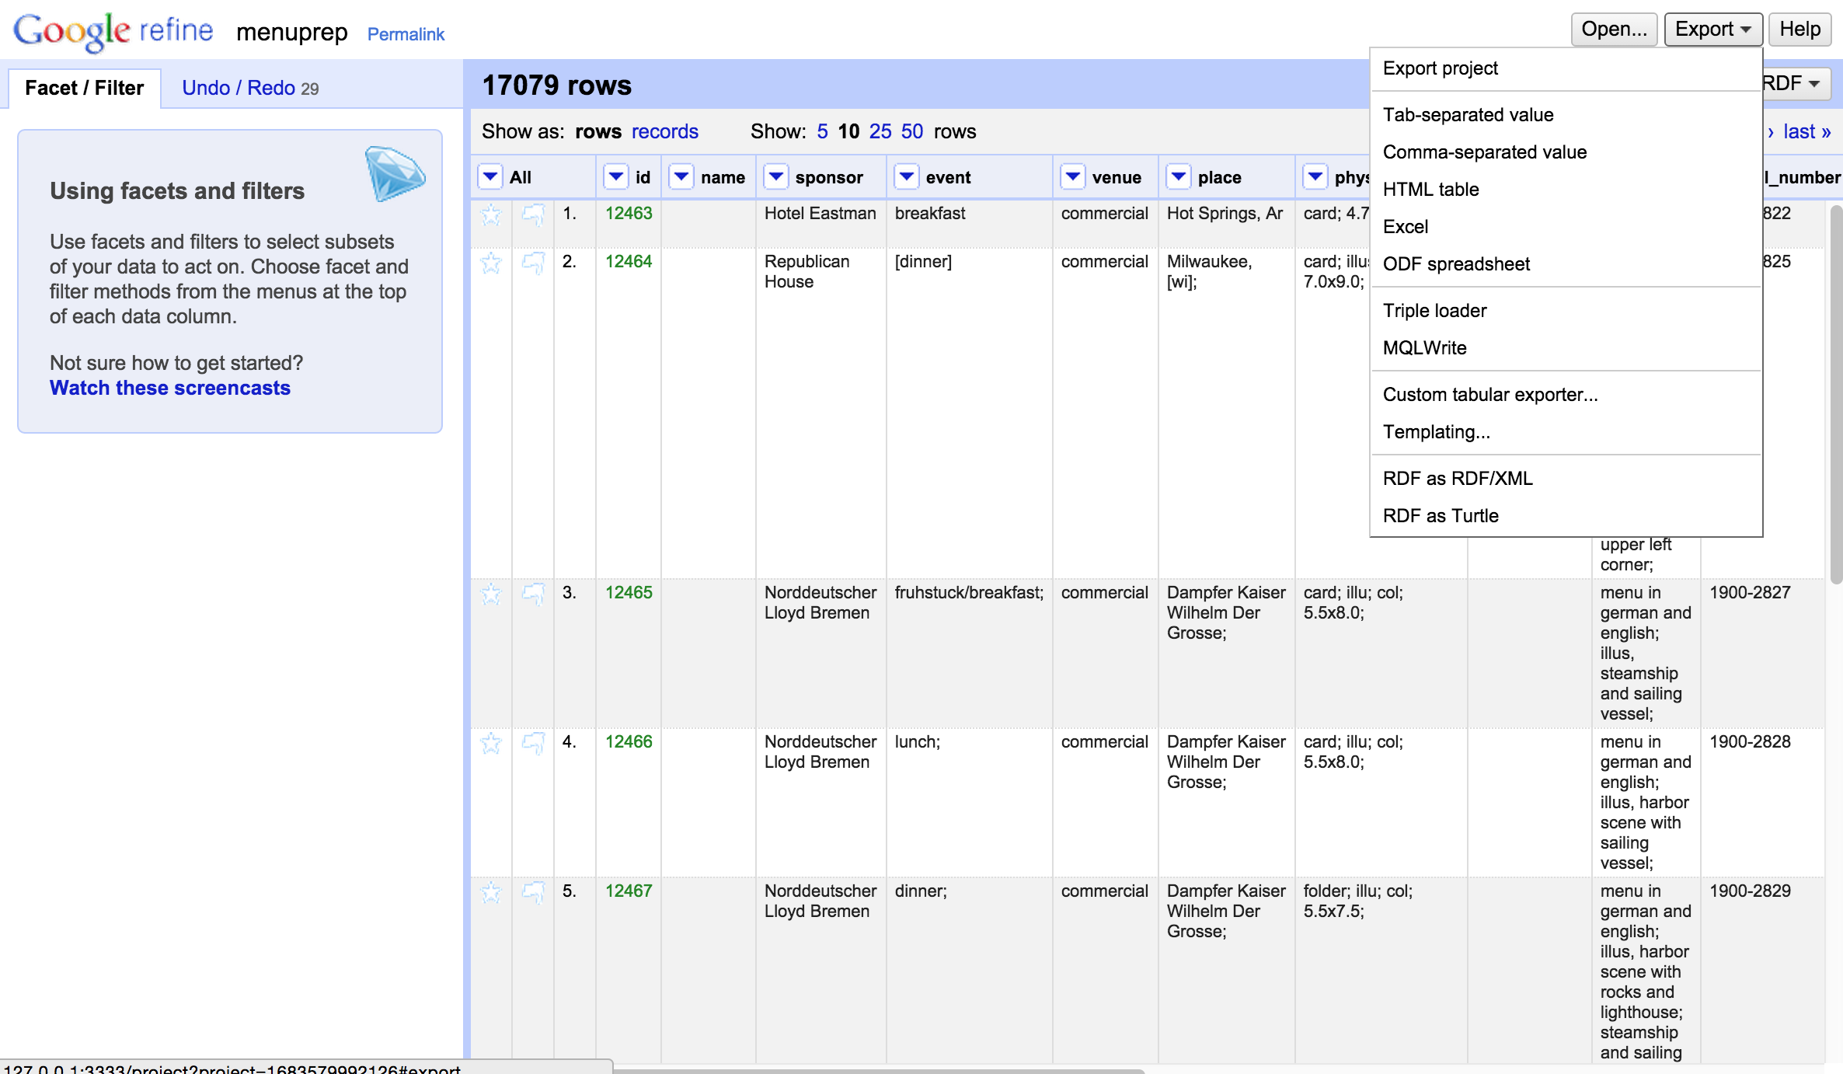
Exporting your Project
Notes:
-- Notice most of your options are in tabular formats
-- BUT if you dowloaded the RDF extension there are also XML and Turtle serializations (which would be especially good to use for your linked data projects)

Slide 33
Further Resources
Main project page (You can download the program here): http://openrefine.org/
Github repository (This is where the source code lives): https://github.com/OpenRefine/OpenRefine
Open Refine Documentation (AKA an extensive user manual): https://github.com/OpenRefine/OpenRefine/wiki/Documentation-For-Users
Additional Reconciliation Services:
There are a several listed here. Nomenklatura & Reconcile-csv may be of particular interest: https://github.com/OpenRefine/OpenRefine/wiki/Reconcilable-Data-Sources
More on GREL: https://github.com/OpenRefine/OpenRefine/wiki/GREL-String-Functions

Slide 34
GeoCoding
Using OpenRefine
(based on a tutorial by Ahmad Assaf: http://ahmadassaf.com/blog/data-analysis/cleaning-geo-data-open-refine/)

Slide 35
What’s that?
To georeference means to associate something with locations in physical space.
Geocoding, or using a description of a location (e.g. a place name, address), to find geographic coordinates, is a kind of georeferencing
In other words, plotting strings like…
“10 feet west of the Thames”
“a mile north of Ann Arbor, Michigan”
“400 W. Elm St, Champaign, IL”
…on a map, to obtain more precise geographic coordinates.

Slide 36
Why do we need it?
Converting geolocations from one format to another is notoriously difficult
(Which is why there are entire field of study concerned with geographic information systems)
Having easily mappable (lat/long or UTM) coordinates makes informatics projects possible
For instance:
Pelagios, a digital map of the roman empire:http://pelagios-project.blogspot.com/2012/09/a-digital-map-of-roman-empire.html
Google Ancient Places: https://googleancientplaces.wordpress.com/
Mapping the Republic of Letters: http://republicofletters.stanford.edu/

Slide 37
How can OpenRefine help?
Converting coordinates can require some complicated wrangling of math, maps and datums
Other services already do this well (Google!)
With OpenRefine, we can call on those services to hugely simplify our workflows

Slide 38
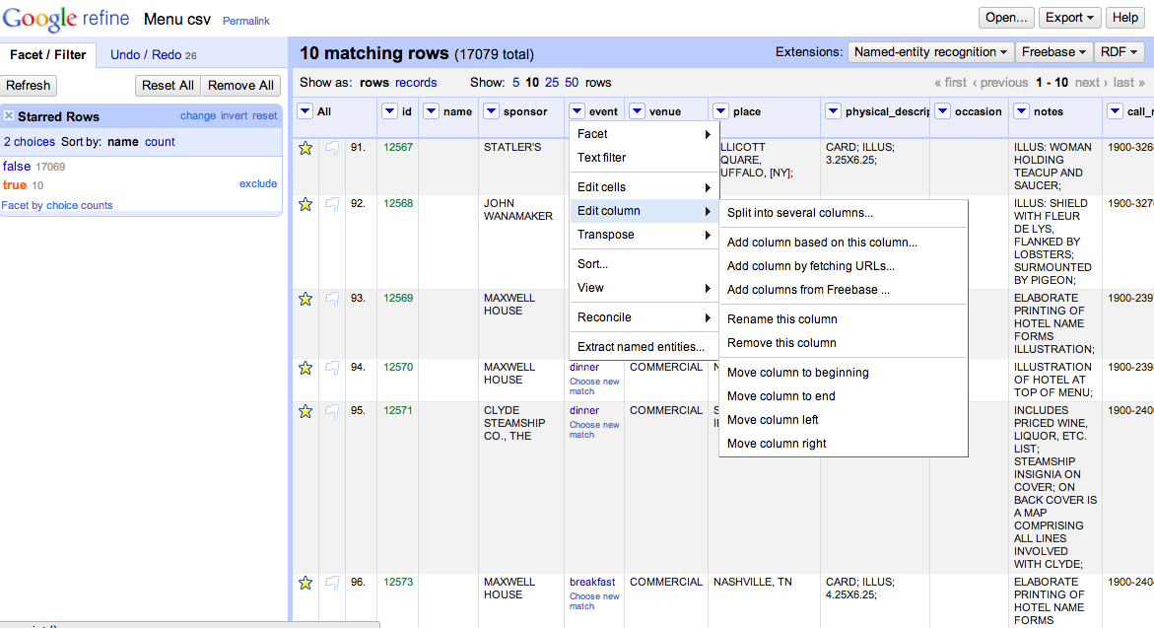
Create a Column for New URLs
Notes:
"http://maps.googleapis.com/maps/api/geocode/json?sensor=false&address="+escape(value,"url")+",+"+cells["City"].value+",+"+cells["State"].value

Slide 39
Wait a second….

Slide 40
Remember: clean your data!

Slide 41
Fetching URLs

Slide 42
Results: JSON!

Slide 43
Parsing JSON

Slide 44
Parsing JSON
Or value.parseJson().results[0].geometry.location.lat
Or value.parseJson().results[0].formatted_address
Or…
Notes:
value.parseJson().results[0].geometry.location.lat
value.parseJson().results[0].formatted_address
value.parseJson().results[0].geometry.location.lng

Slide 45
We’re ready to make maps!

Slide 46
From Restaurants to Road TRips
The National Register of Historic Places
Notes:
Let’s use a different dataset to demonstrate data reconciliation

Slide 47
Reconciling with Linked Data
What you’ll need:
A fairly clean data set
Navigate to http://bit.ly/DHOxSS_HumDat
Select nrhp_illinois_moundsites_links.xlsx in
Monday > OpenRefine
An RDF extension (http://refine.deri.ie/)
One or more added reconciliation services
A lot of patience
Notes:
-- To exploit semantic web technologies, you can begin by linking your data to other datasets.
-- I won’t show you the steps for installing extensions here, but I included a link to the download in the initial joining instructions.
-- If you haven’t installed the extension, this link has a set of tutorials for installation and adding reconciliations services
-- You can add any project with a SPARQL endpoint as your reconciliation service, W3C has a list of 40 or so
-- SPARQL is the query language for RDF.
-- RDF is a model for data interchange over the web.

Slide 48
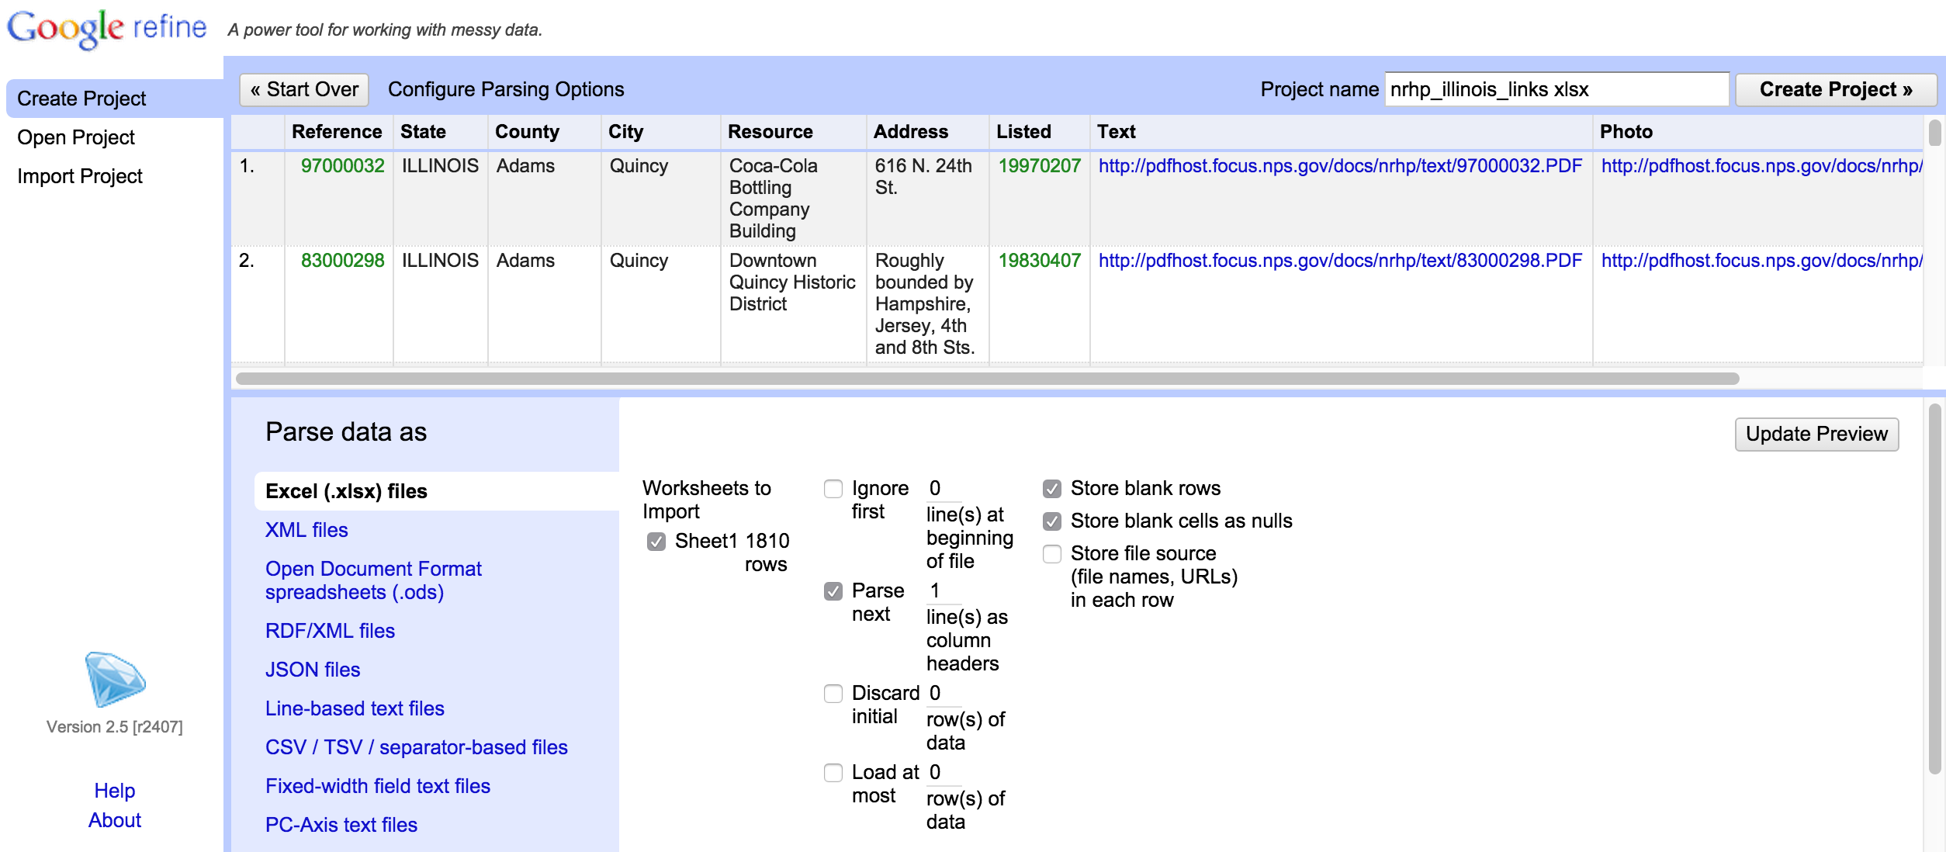
Create, Open, or Import a Project

Slide 49
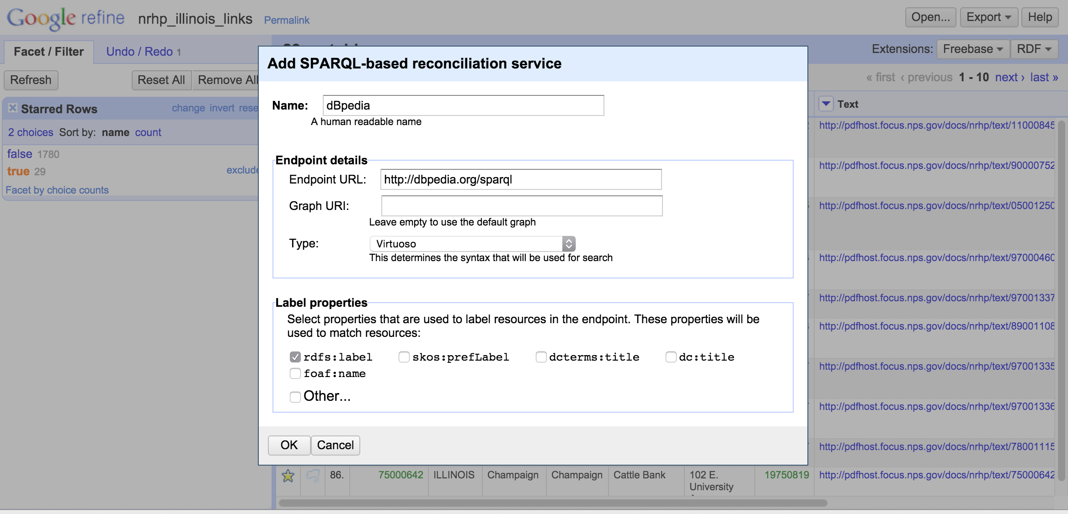
Add a Reconciliation Service
DBpedia extracts structured information from Wikipedia
and makes it available as a SPARQL endpoint.

Slide 50
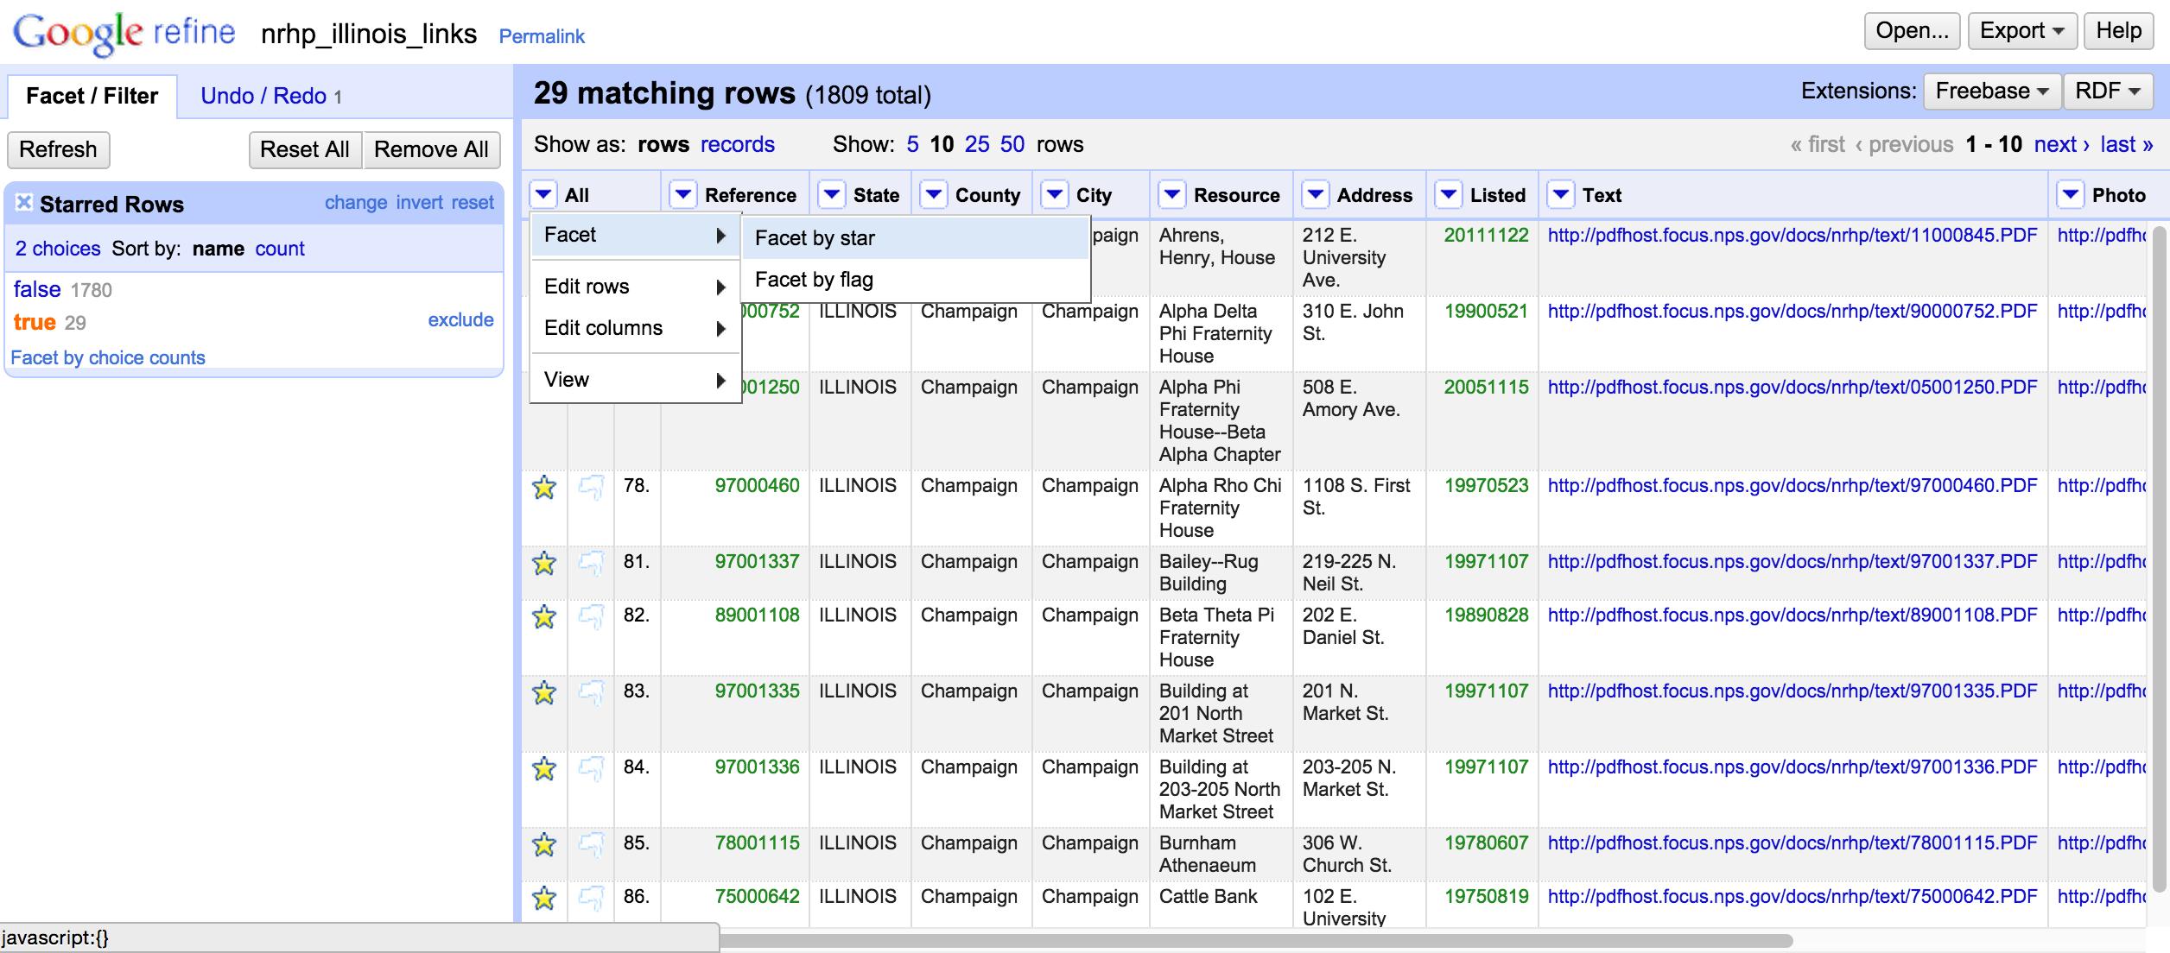
Start with Subset of Data
Star a small set of rows for for an initial test set, facet by star, and select “true”.
Notes:
-- 10-20 rows would be okay for a test run
-- if you do all 1800 rows, you’ll be waiting an awfully long time so do start with a smaller sample.
-- note that you now see the RDF option after “Extensions” on the upper right-hand side

Slide 51
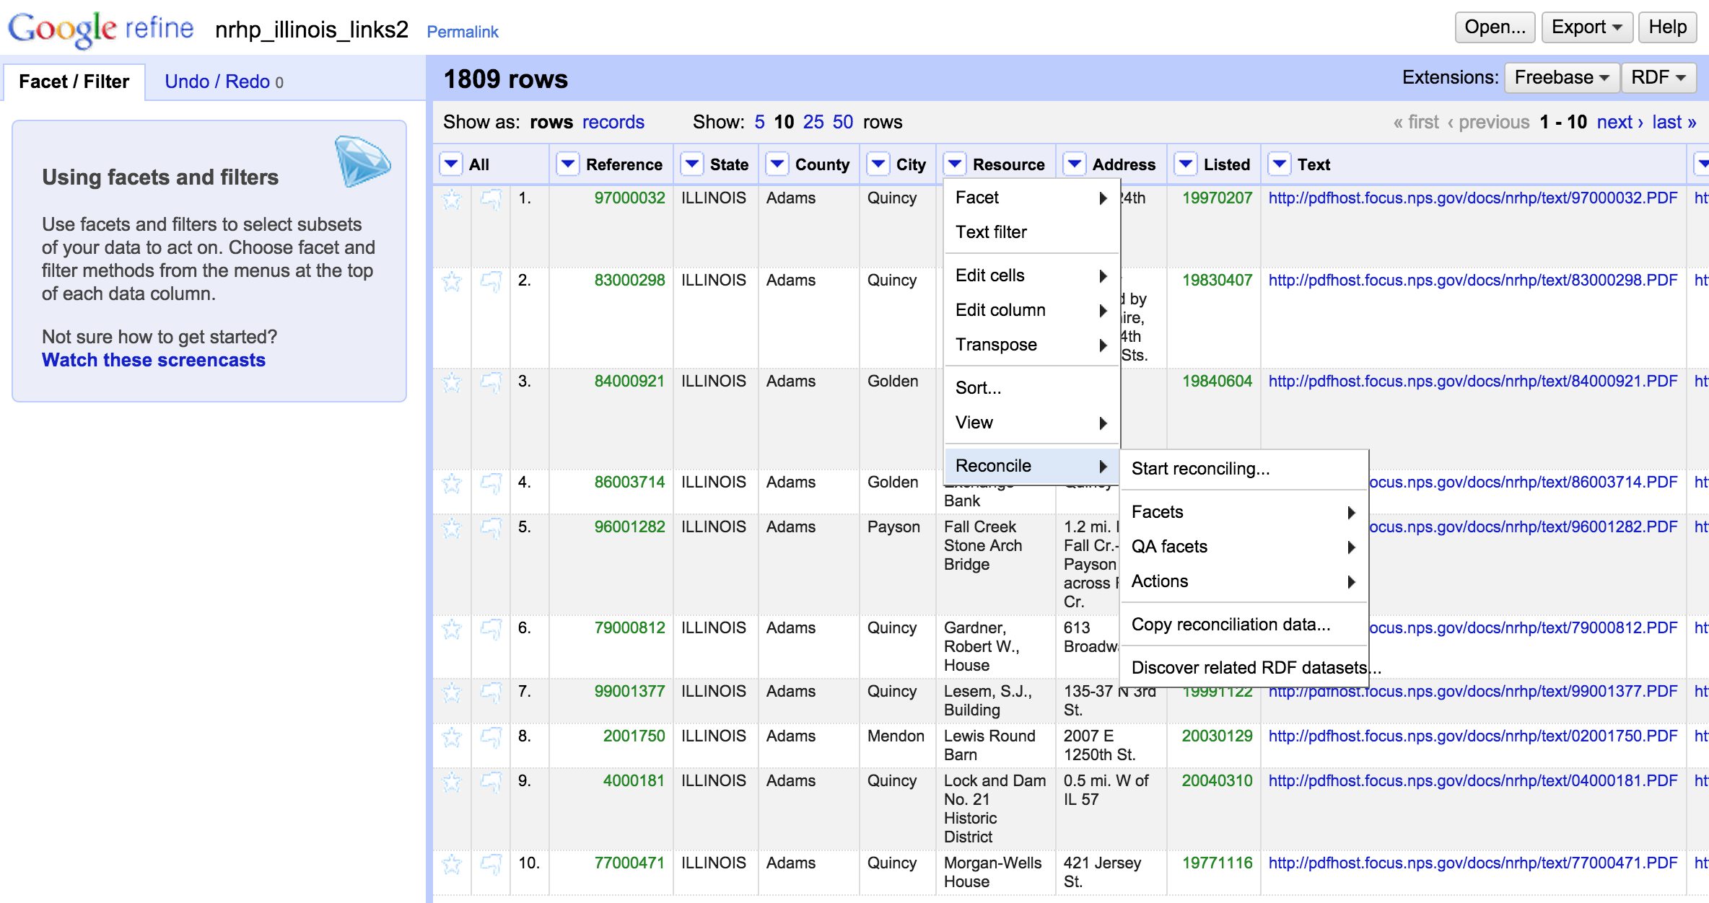
Choose which Column to Reconcile

Slide 52
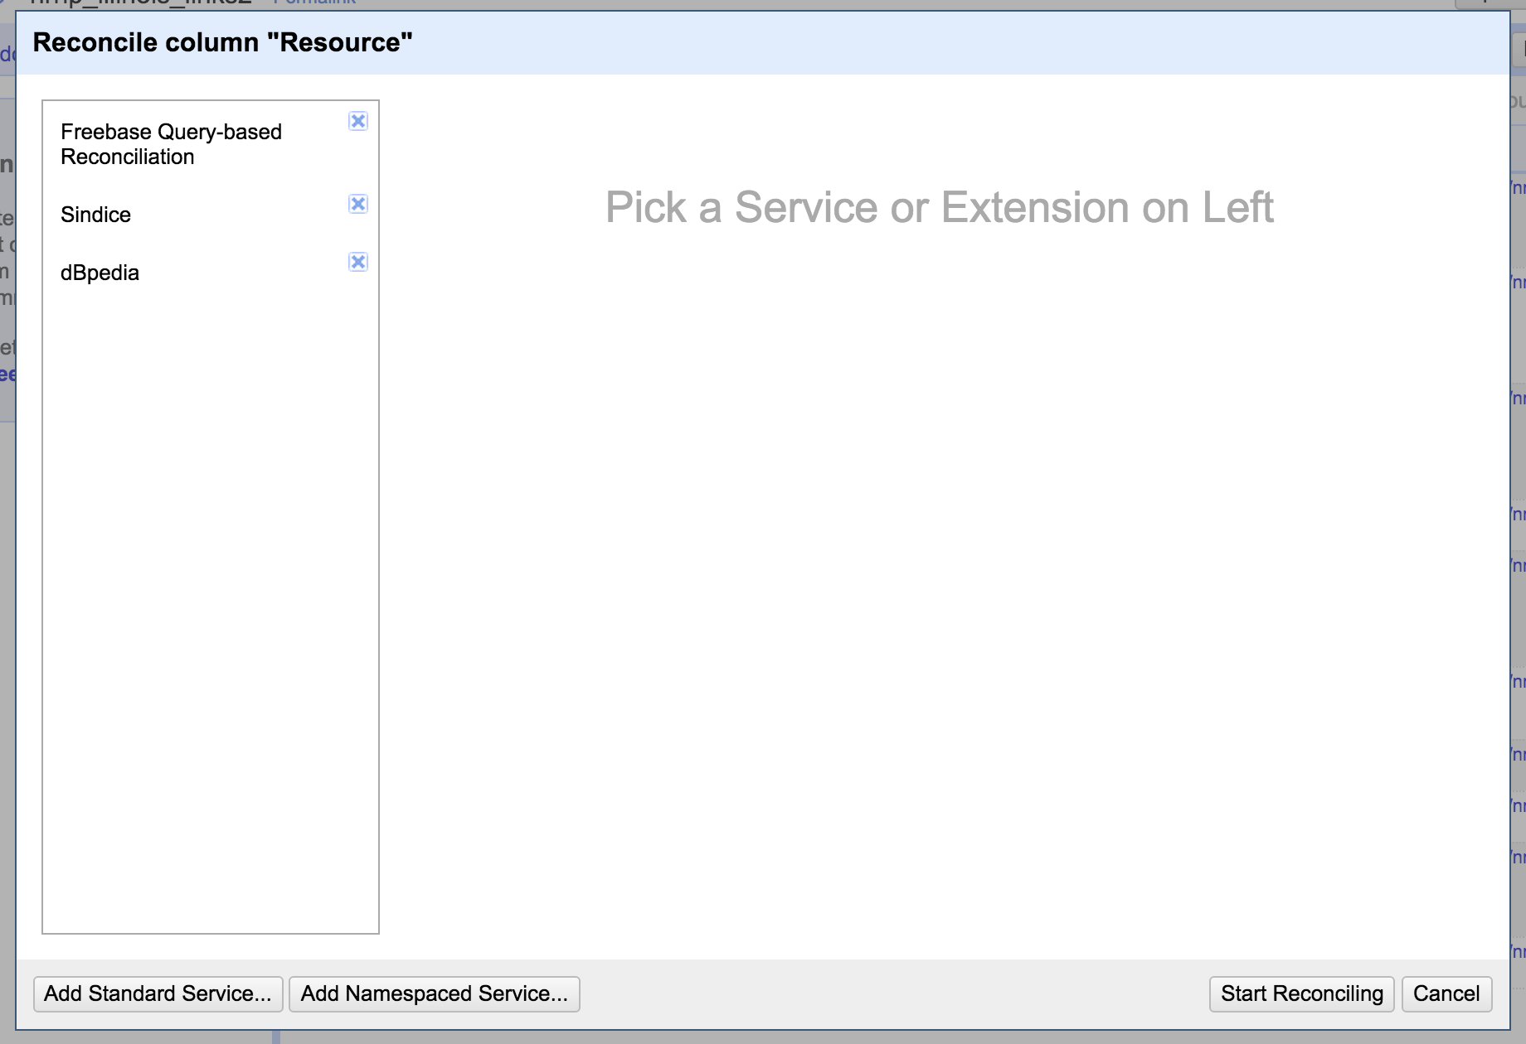
Choose your Reconciliation Service

Slide 53
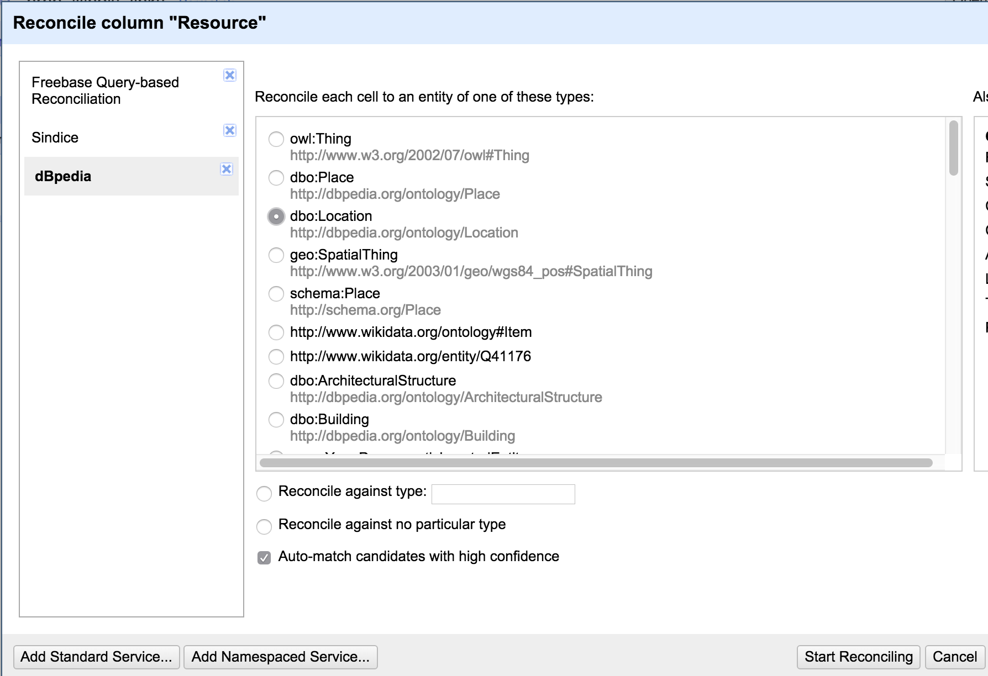
Choose a Type of Reconciliation
If you aren’t sure which name space or class to use, you can usually find additional information about these ontologies online.

Slide 54
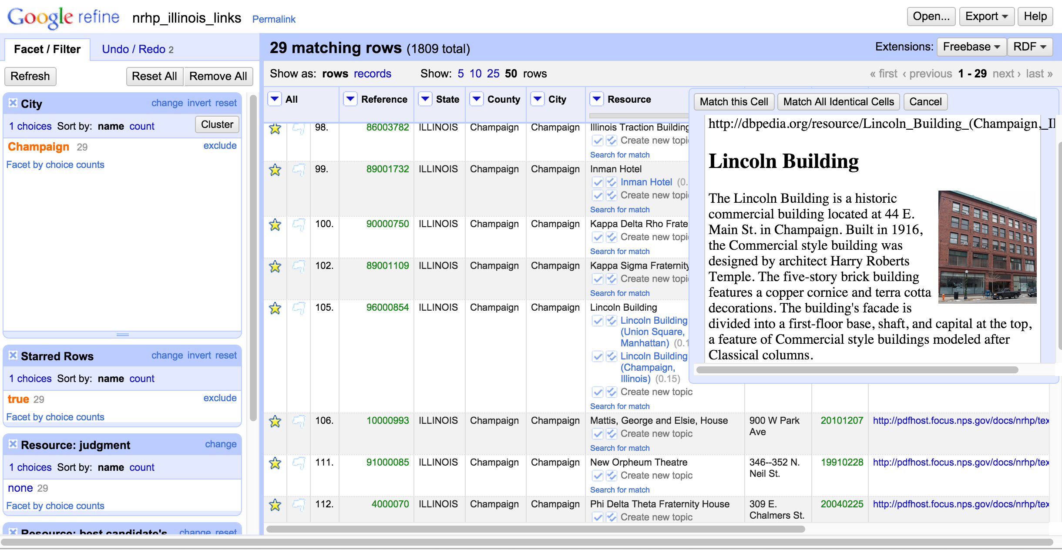
Review Results
Notes:
-- High confidence results are linked automatically
-- Lower confidence results are offer the best suspected match and a confidence rating
-- Where absolutely no option is given, you’re next step is to search manually
-- In this instance my first reconciliation attempt only garnered 3 correct matches (using dbpedia location ontology)

Slide 55
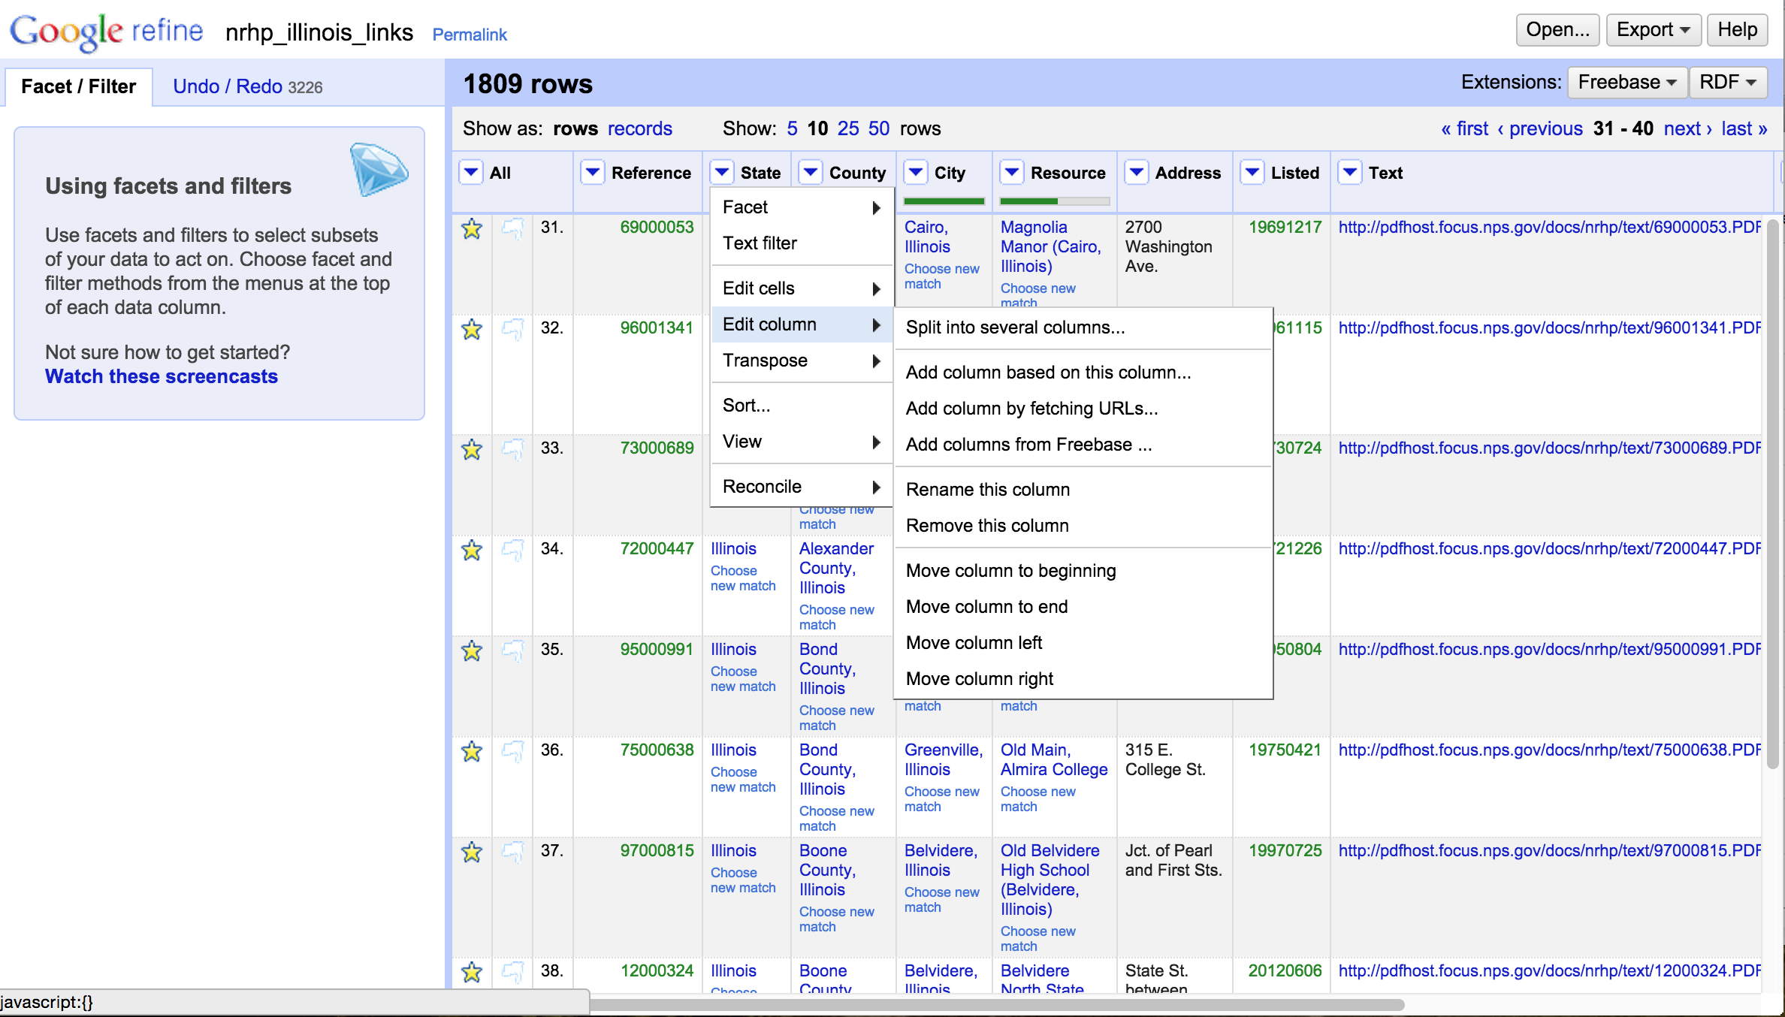
Create a Column for New URLs

Slide 56
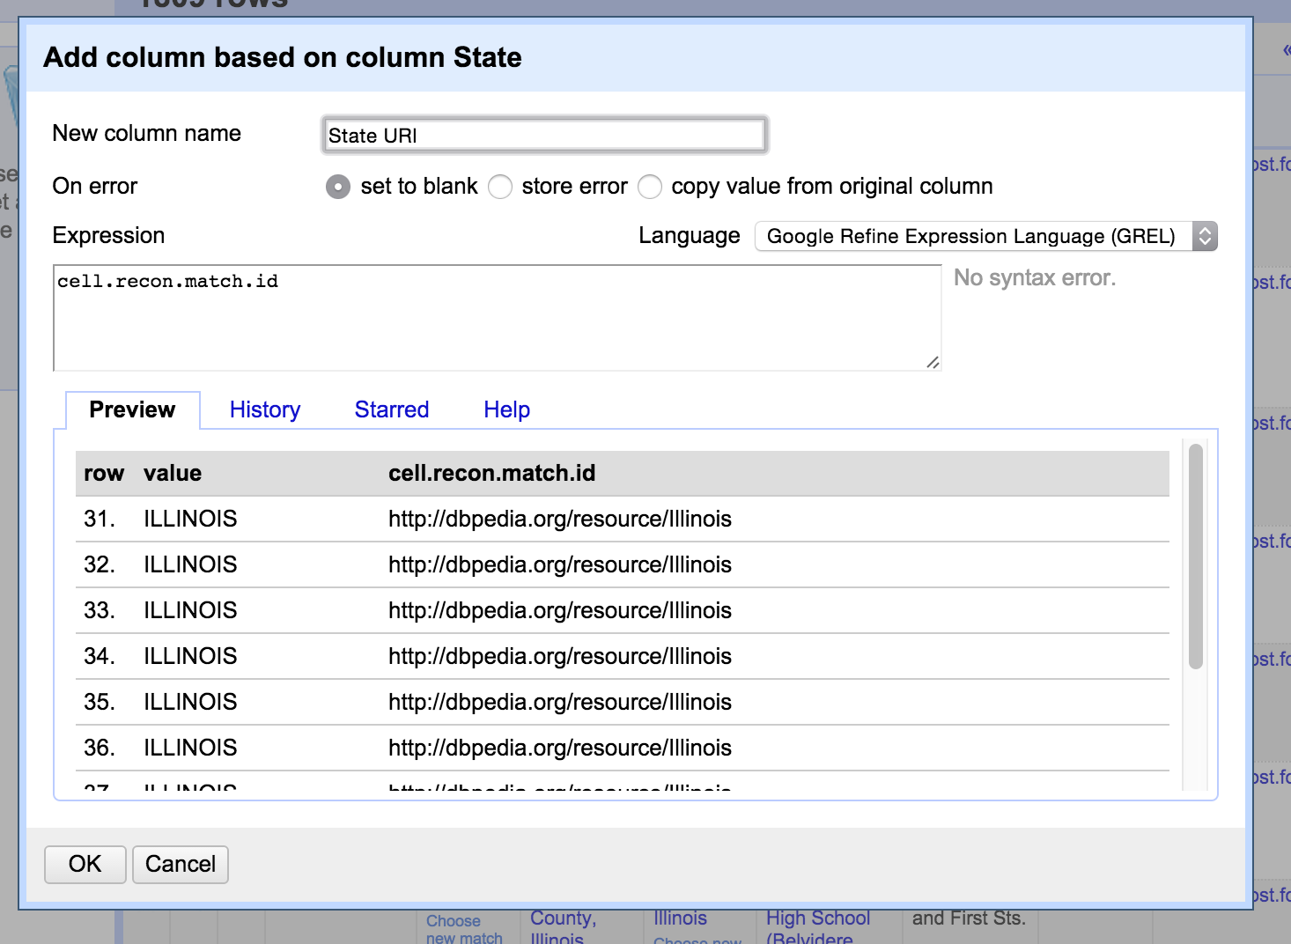
Create a Column for New URLs
Notes:
-- Name your new column
-- URL is a type of URI (uniform resource identifier)
-- Enter the expression that extracts the ID from the matched reconciliation information for each cell
-- GREL is default expression language; can also use Clojure and Jython

Slide 57
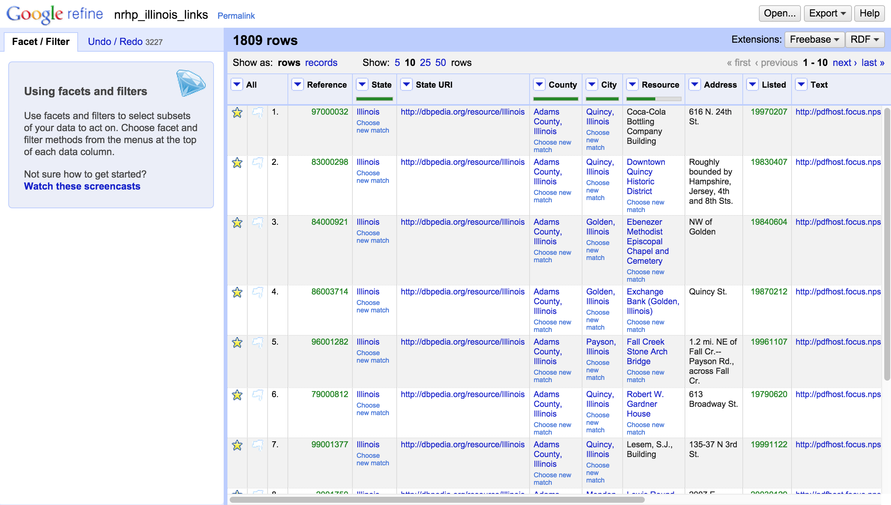
Review URI Column
Each event cell now has a unique identifier and a path to discover related information from other data sets.
Notes:
This is a really time consuming process, but it’s a great way to add value to your data and improve your prospects for meaningful sharing and reuse.

Slide 58
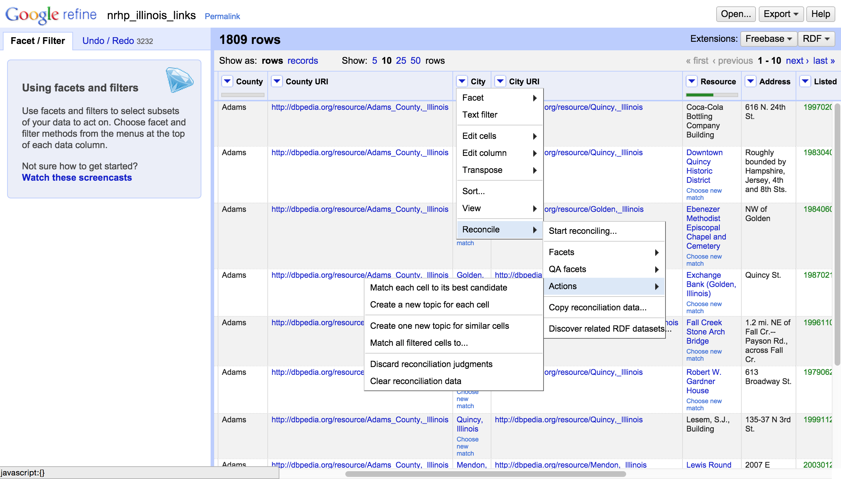
Clear Reconciliation Data
Notes:
-- You may have noticed that in the process of reconciliation redundant data were added to our cells
-- This isn’t ideal
-- Luckily, you can clear reconciliation data in the original column to return it to it’s original state

Slide 59
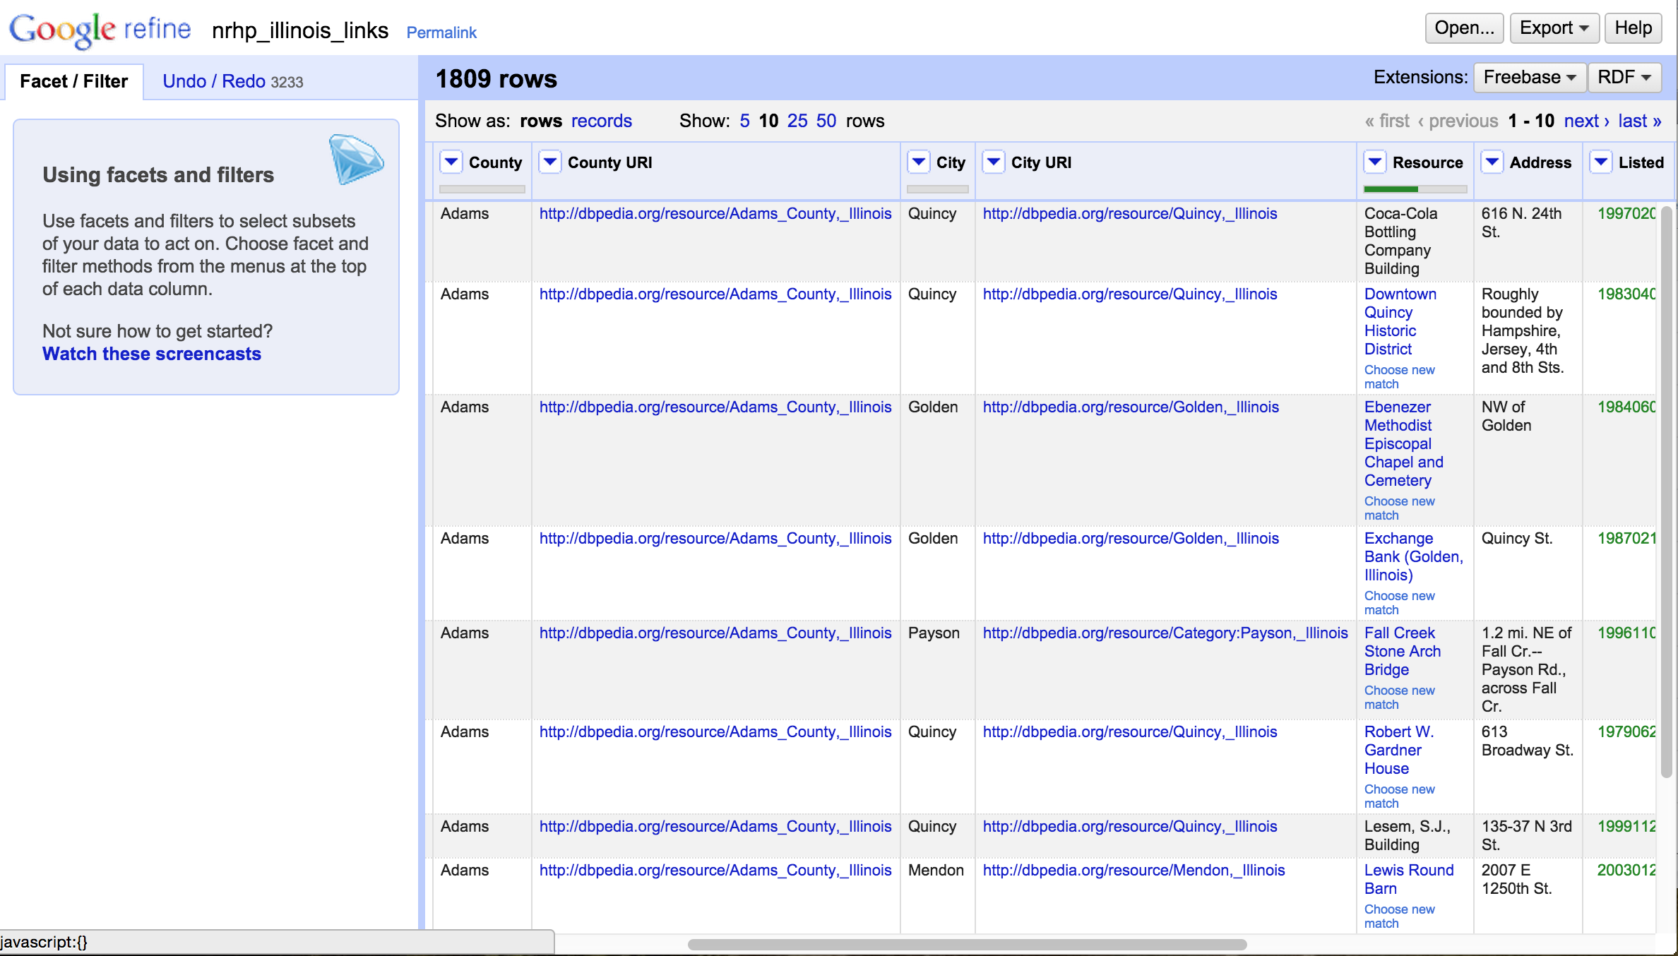
Clear Reconciliation Data
Notes:
Now “Quincy, Illinois” just has the name of the city without disambiguating by state.

Slide 60
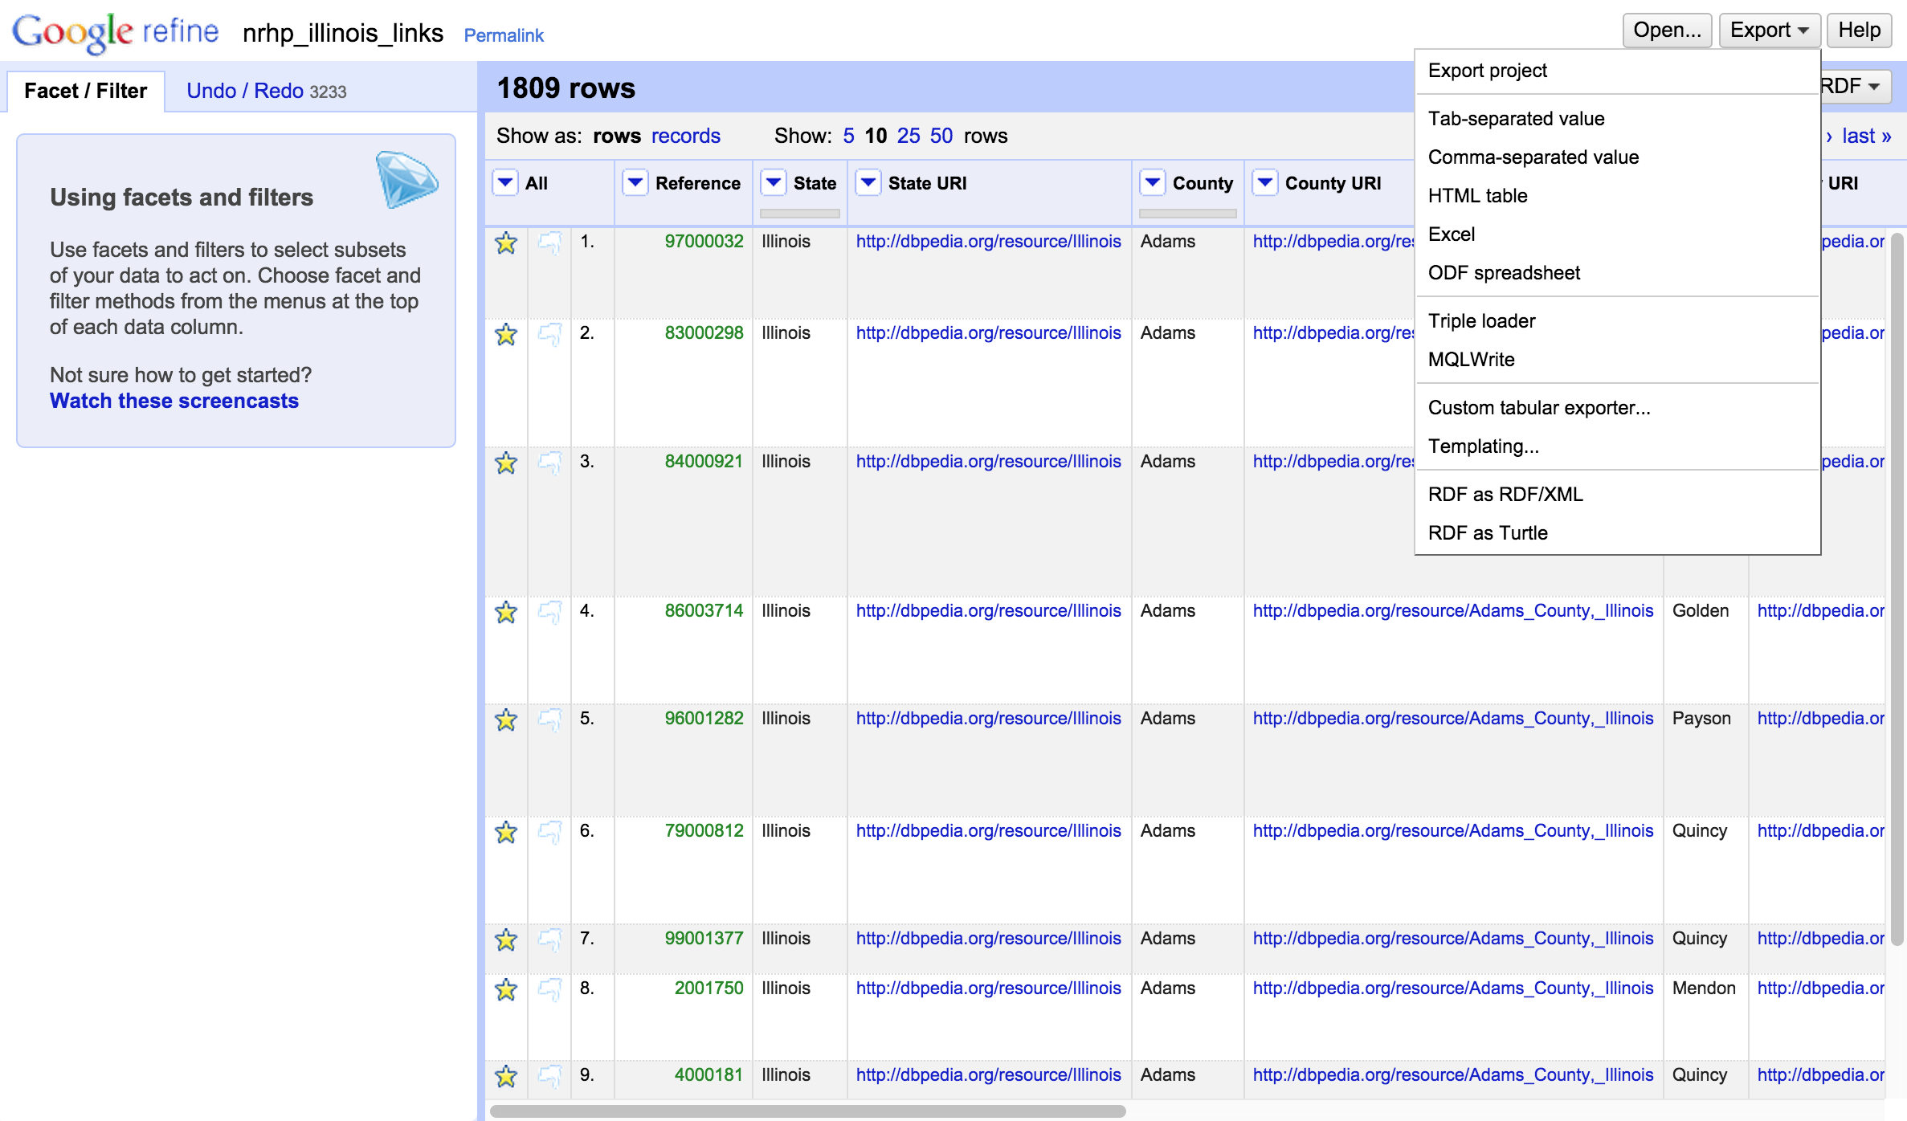
Exporting
… not so fast!

Slide 61
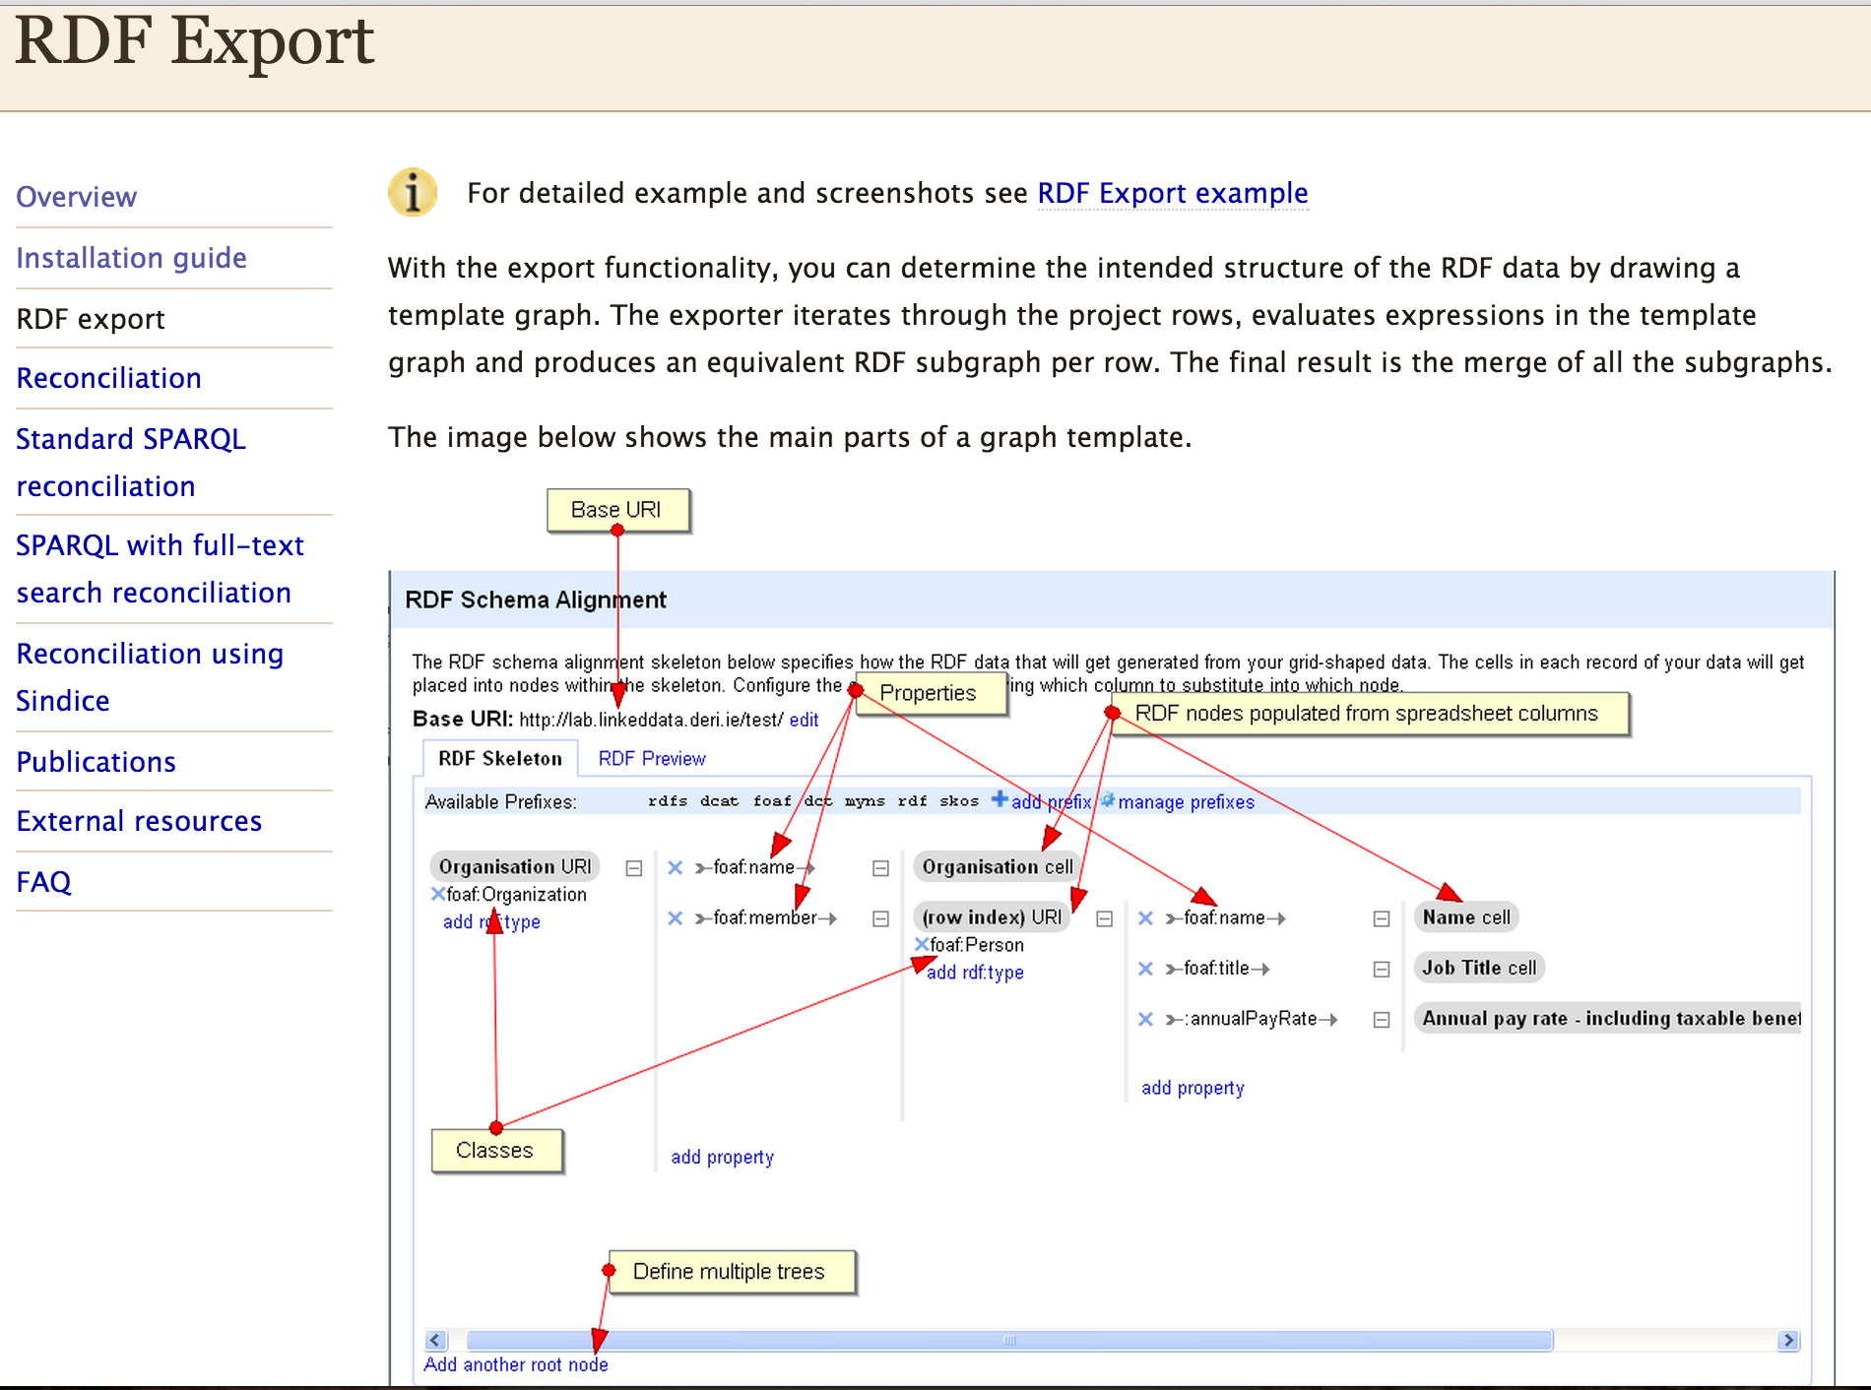
Caveat on Exporting to RDF
http://refine.deri.ie/rdfExportDocs
Notes:
-- Exporting to RDF requires a fair bit of schema alignment.
-- We don’t have time to review that today
-- Detailed instructions and examples are available on the website where you dowloaded

Slide 62
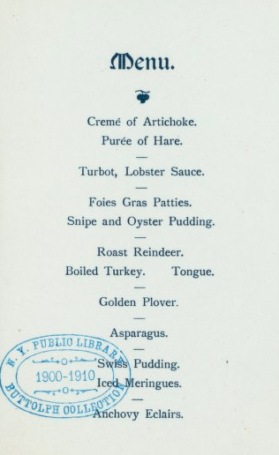
Discussion and Questions
Menu
Hertford College, Oxford, UK
7 March 1907
Notes:
In honor of tonight’s dinner at Wadham, I found the only Oxford menu in the entire dataset…

Slide 63
Acknowledgments
The NYPL portion of this exercise was created at the Maryland Institute for Technology in the Humanities and developed through the Digital Humanities Data Curation Institute series, generously funded by the National Endowment of the Humanities.
Special thanks to Trevor Muñoz and Lydia Zvyaginsteva!

